Slide 1
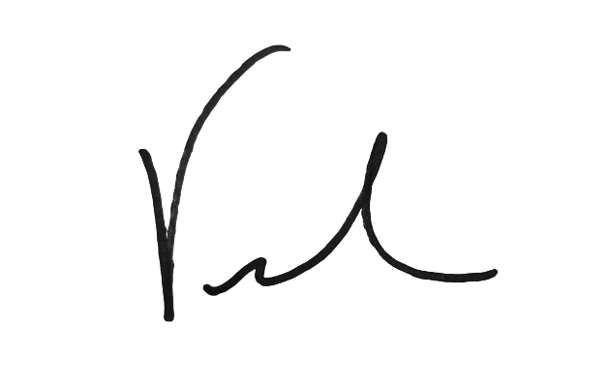
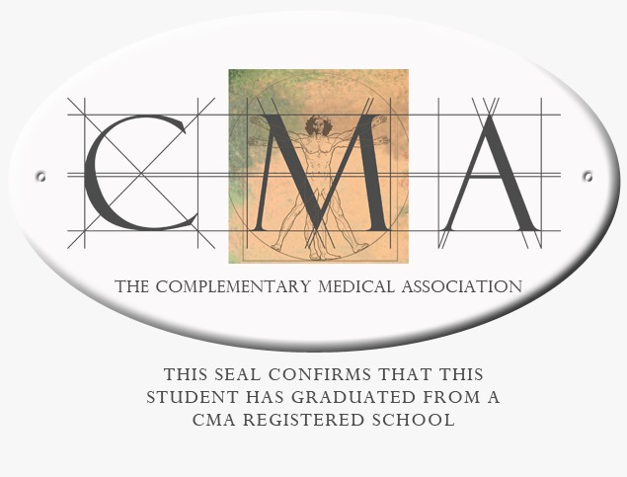
Congratulations
Kate Maranville-Hiser
Certified Sound Healer: Level 1
Fundamentals
Vickie Gould
Life Changing Energy

