Slide 1


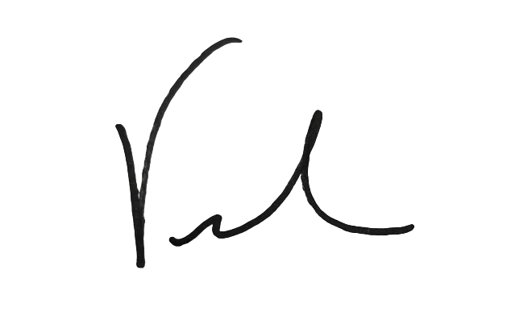
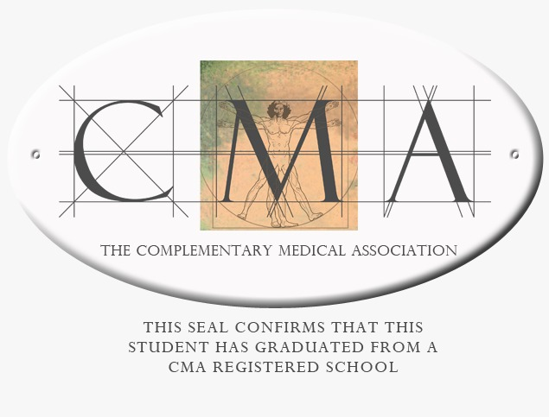
Congratulations
Conner Romanowsky
Certified Sound Healer: Expert Level
Vickie Gould
Life Changing Energy

