Slide 1
Navigating Forks in the Road: Divergent Career Paths of Women Leaders in CL Psychiatry:
Navigating Early Career Leadership and Utilizing the CL Lens
Sejal B. Shah, MD, FACLP
Chief, Division of Medical Psychiatry
Associate Vice Chair, Clinical Consultation Services
Brigham and Women’s Hospital
Notes:
Thank you, Madeleine, for setting the stage for this important area.
My focus will be on early career leadership and utilizing a CL lens to pursue hospital-level and national leadership roles.

Slide 2
Volume 393, Issue 10171
Pages 493-610, e6-e28 (9–15 February 2019)
Notes:
-The Lancet devoted an entire issue a couple of years ago to women—advancing women in science, medicine and global health
So as important as it is for us to listen and learn from each other, we also need to demand that these issues are visible in the literature
-welcome to the women listening to this talk and thank you to the men as well for being allies!
-a talk like this can easily devolve into a narcissistic memoir—a talk with too many “I”s and “me”s
-my hope is that in talking about my path, I will focus on what has been helpful to me; with a particular emphasis on early career leadership and how CL expertise can open up doors to follow non-traditional paths

Slide 3
My Path
Chief Residency
CL Division Leadership
Medical Education Leadership
Hospital-Level Leadership
National Leadership Positions
Notes:
-was not a natural leader; earlier in my life—tended to shy away from taking the lead—I was very good at following others and abiding by others’ rules
-residency was the first time that I showed an interest in leadership
-organizational skills and a big picture view can be translated into leadership: I enjoyed ”making the trains run on time”
-found that leadership could make a difference on a larger scale
-passion for the clinical work and wanting to inspire others
-took on leadership early in my career
-in my first job out of fellowship, I took on positions of assistant director of the CL division and associate program director of the CL fellowship; it was a great melding of my interests in medical education and administration
-a less here is don’t shy away from early career leadership
-you might hear things like “there’s plenty of time” or “what’s the rush”—I actually heard that from other women; do what is right for you
-no magic time when you’re “ready” for leadership; you don’t wake up one day and feel ready
-about 6-7 years into my career, I was asked to take on some hospital administration work which I’ll go into more detail about on the next slide
-the important part about leadership that I’ve learned over the years is to show up. Consistency and a willingness to be present and take on hard challenges is valued.
-and the CL lens is invaluable to hospital leadership
-ACLP inspired me to pursue leadership at a national level
-I loved collaborating and gaining ideas from colleagues outside my immediate sphere
-a couple of years ago, I became the Chair of the American Psychiatric Association Council on Consultation-Liaison Council
-it’s been important to me to elevate CL psychiatry on a national level—advocating for our work and our field as well as advocating for our patients

Slide 4
“C-L Lens”
Workplace Safety
Patient at Risk Committee
Hospital Psychological Support
SARS-CoV-2 Pandemic: Crisis Standards of Care
Hospital-Level Policy Work
Physicians’ Organization Board of Trustees
Notes:
-so why CL psychiatry—what makes our specific skill-set valuable?
-the skills of a CL psychiatrist are invaluable in many areas of medicine—specifically, our knowledge of medical illness and its intersection with not only psychiatric illness but human behavior. Our knowledge of systems and particularly interventions when systems fail are needed in leadership. Navigating how to “get to yes” is invaluable. We have a quality improvement mindset which hospital leadership specifically values.
-don’t underestimate that we are the face of psychiatry for a hospital or health system and we are the conduit to the rest of medicine
-Hospital-level leadership:
“Patient at Risk Committee” (PARC). This was commissioned by the CMO and CNO and sits under the Department of Quality and Safety (under the umbrella of a group that works on workplace safety and violence prevention). The CMO/CNO wanted a CL psychiatrist involved given our understanding of human behavior as well as complex medical illness. Issues tackled by this multidisciplinary committee include things like violent behavior, threats of violence, sexually inappropriate behavior or harassment/abuse or episodes of explicit racism.
Members: nursing, security, physician leadership, risk management, ambulatory care, patient-family relations, psychiatry, social work, emergency medicine and diversity, equity & inclusion leadership
-allows me to think about human behavior in a different realm than my usual day-to-day work
-the committee works to advocate for patients to continue receiving care in the safest manner possible; our tolerance for “bad behavior” and being curious about its context serves us well
-Many of us are often called up on to provide psychological support across the hospital; I’ve been involved with support surrounding various events such as the Boston Marathon Bombing, a tragic shooting death of a cardiothoracic surgeon at my hospital, an active shooter event just prior to the pandemic and then of course support surrounding the pandemic itself.
-utilize CL skills to elevate yourself in your own hospital system
-More specifically, we set up psychological support in the context of potentially needing to activate crisis standards of care or allocation of scarce resources; CL psychiatry was thought to have the expertise to help support leaders across medicine who would serve on these panels making the decisions to restrict or even intervene to stop care of patients
-so not only was my team at the frontlines of helping to manage the pandemic but also there to support the hospital system as a whole
-More recently, I’ve gotten involved with hospital-level policy work related to anti-racism efforts; what to do when patients are overtly racist; how do we manage patients’ biased demands; do we look at a Spanish-speaking patient asking for a Spanish-speaking provider differently than a While male patient asking to only be seen by a white male attending physician?
-again, the CL lens of utilizing liaison skills and managing difficult system-level issues is invaluable
And lastly, I am a physician trustee on our physicians’ organization board of trustees. This allows me the ability to advocate for our most vulnerable patients who have historically been underserved given a lack of resources. But other roles also involve participation in wellness efforts and program development.

Slide 5
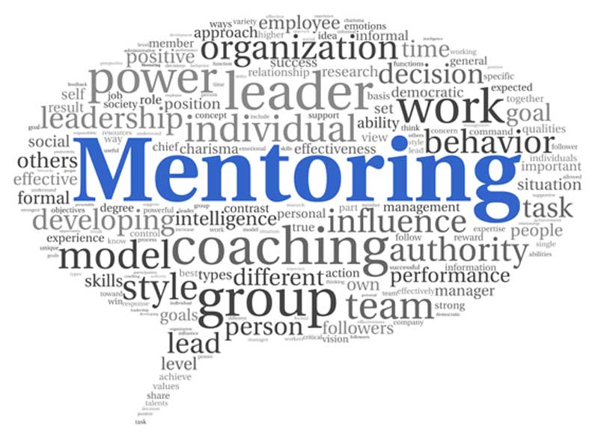
Importance of Mentorship
Strong Female Mentorship
Leadership Courses
Networking
Notes:
Mentorship is priceless
-my primary mentor in CL is a wonderfully selfless man but it took me a few years to understand the importance of seeking out strong female mentorship
-even when I was achieving my career goals, I didn’t know what I didn’t know—how to manage some of the challenges that I’ll talk about in the next slide
-overall, choose mentors who push you to pursue challenging things but also allow you to choose your own path rather than the one they think is best for you
-identify multiple mentors who can aid you with various aspects of your career; my mentors for leadership in CL are not the same people as those mentors who have guided me in my hospital-level work
Mentorship can take on many forms
-expand your skills: participate in leadership courses—this is where I’ve gotten some of my most productive ideas for the teams I work with
-a great place to network and be challenged
-smaller leadership forums—such as PD workshops highlight the universality of leadership challenges (psychiatry is not unique!)

Slide 6
Challenges
Microaggressions
Race/Ethnicity
Age
Gender
Value Yourself— Negotiate!
Choosing a “Path”
Family Obligations
Notes:
Leadership is not without its challenges
Some of mine can be captured under the broad umbrella of microaggressions
-being a woman and a woman of color
-being the youngest person in the room; having to prove your worth; others claiming to know what your path should be
-navigating a hierarchical environment
Some of the same recommendations stand—show up consistently and those that are your advocates will notice. Let your work speak for itself. I spent many years trying to prove myself by noting that I belonged in the room. I then learned that my work could speak for itself.
-understand your worth—negotiate for time to participate and lead
-You WILL face forks in the road
-for me, the question became, am I a psychiatrist in hospital administration or a hospital administrator who happens to be a psychiatrist; my clear conclusion was the former; my identity as a psychiatrist and particularly a CL psychiatrist was and continues to be prominently important to me
-balancing family obligations…aging parents and ensuring that I am managing that while balancing all of my responsibilities at work. Many of my colleagues know that I’ve had several instances of having to go back and forth to my parents’ home to help take care of them and their various medical issues. These obligations often fall to women—it’s important to prioritize and find mentors that understand the importance of separating work and personal life; good bosses also understand this.

Slide 7
Pearls
Pursue Challenging Opportunities
Allow Yourself to Fail
Show Up!
Know Your Worth
It’s Okay to Say No
Align Leadership Opportunities with Your Values
Pay It Forward!
Notes:
So some final pearls:
-leave your comfort zone
-it’s okay to fail—allow yourself to do so and forgive yourself for it
-it’s okay to be outspoken and have unpopular opinions
-to get noticed and be taken seriously, show up and keep showing up
-know your worth—negotiate for time—for leadership courses, program development and administration/leadership
-women tend to volunteer their time, particularly for things they are passionate about
-notice what your values are and align them to your work—that passion will drive you
-it’s okay to say no to those opportunities that do not align with those values or your interests
-and lastly, mentor others and let trainees follow their own path
-Thank you. I now want to hand it over to my colleague, Dr. Leena Mittal.

