Slide 1
The ACLP Diversity, Equity, and Inclusion Task Force: Promoting Critical Change for Our Trainees, Members, Patients, and Field
Kewchang Lee, M.D.
Clinical Professor, Department of Psychiatry and Behavioral Sciences, University of California, San Francisco (UCSF)
Program Director, Consultation-Liaison Psychiatry Fellowship, UCSF
Director, Psychiatry Consultation, San Francisco VA Health Care System

Slide 2
CLP 2021 Kewchang Lee, M.D.
With respect to the following presentation, there has been no relevant (direct or indirect) financial relationship between the party listed above (and/or his husband) and any for-profit company which could be considered a conflict of interest.

Slide 3
Learning Objectives
Develop a greater understanding of how diversity, equity, and inclusion (DEI) can be promoted in multiple aspects of ACLP
Understand the process of how the ACLP DEI Presidential Task Force developed its recommendations and report
Appreciate the implications of the task force’s recommendations with respect to future DEI efforts within ACLP

Slide 4
Process: Spring/Summer 2020
ACLP Board of Directors approves formation of DEI Presidential Task Force
Maria Tiamson-Kassab asks Kewchang Lee to chair
We meet with Michael Sharpe and James Vrac to discuss charge and membership

Slide 5
Task Force Charge from Dr. Sharpe
To identify areas of improvement and make recommendations to the Board regarding DEI in:
Membership and fellowship recruitment
Committee and subcommittee appointments
Board and Executive Committee appointments
Annual Meeting
Awards
Journal

Slide 6
Task Force Membership
Kenneth Ashley, MD, FACLP, Mount Sinai Beth Israel Hospital & Icahn School of Medicine at Mount Sinai
Kristin Beizai, MD, FACLP, VA San Diego Healthcare System & University of California, San Diego

Slide 7
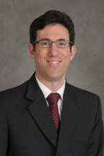
Task Force Membership
Mark Bradley, MD, FACLP, VA New York Harbor Healthcare System & New York University
Brian Bronson, MD, FACLP, Stony Brook University Hospital & Stony Brook University

Slide 8
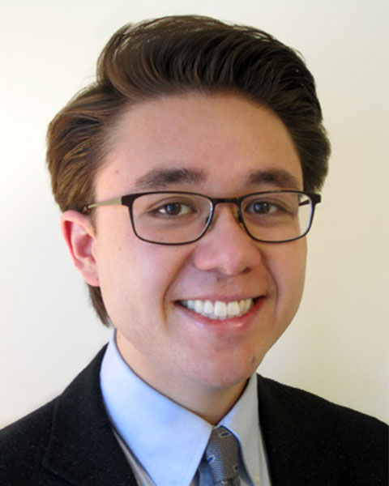
Task Force Membership
Mary Jo Fitz-Gerald, MD, MBA, FACLP, Louisiana State University (LSU) Health Sciences Center & LSU
Andrew Halls, MD, C-L Psychiatry Fellow, University of California, San Francisco, & San Francisco VA Health Care System

Slide 9
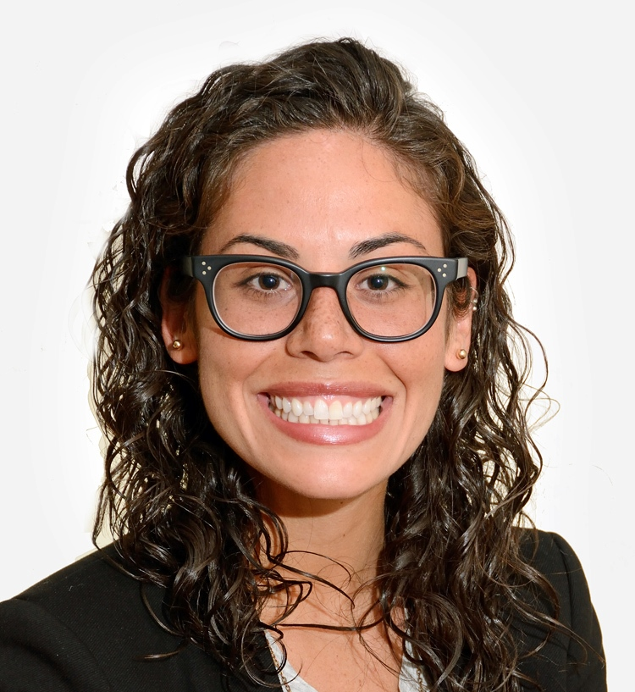
Task Force Membership
Leena Mittal, MD, FACLP, Brigham and Women’s Hospital & Harvard University
Cristina Montalvo, MD, VA Boston Healthcare System & Boston University

Slide 10
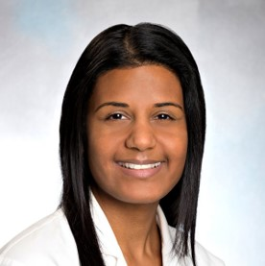
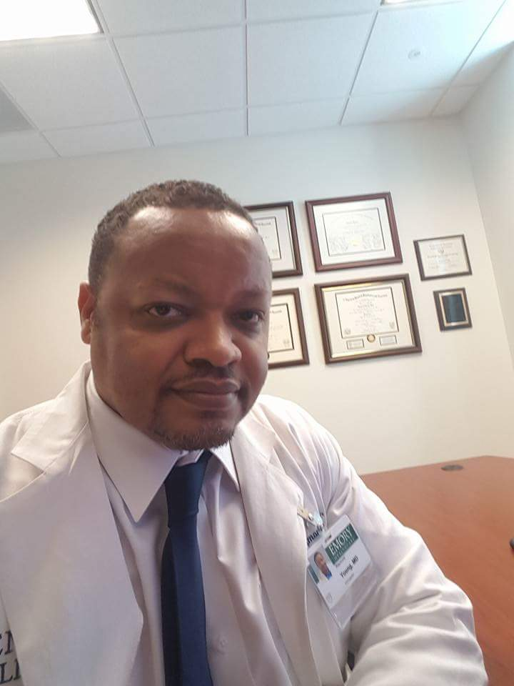
Task Force Membership
Sejal Shah, MD, FACLP, Brigham and Women’s Hospital & Harvard University
Raymond Young, Jr., MD, FACLP, Emory Healthcare System & Emory University

Slide 11
Precepts of the Task Force’s Work
Systemic bias and discrimination have demonstrably adverse health effects on our patients and reduce the professional and training opportunities available to our members
C-L psychiatrists play a key role in translating our understanding of the psychological and structural harms of systemic bias into positive changes in medical practice, education, and systems of care
It is critical to ensure the sustainability of the implementation of the task force’s recommendations across multiple dimensions of diversity
We must acknowledge the intersectionality of these dimensions for C-L psychiatrists, our trainees, and our patients

Slide 12
Precepts of the Task Force’s Work
We must emphasize the importance of implementing the task force’s recommendations to create a culture that fosters a sense of belonging and inclusion, regardless of how members identify
DEI is relevant to multiple aspects of our field, including our work as educators recruiting trainees, as members of an organization seeking to recruit a more diverse membership, and as researchers and clinicians seeking to reduce health care disparities among our patients who come to us with diverse backgrounds and identities and varying degrees of disenfranchisement

Slide 13
Task Force Process: September 2020 - January 2021
Monthly task force meetings
Creation of subgroups to develop proposals on:
How to enhance DEI in ACLP membership, recruitment, leadership, and its governance structure
How to institute pipeline and underrepresented-in-medicine (URM) mentorship programs
How to incorporate DEI into webinars, trainee and member curricula and education, and faculty development
How to further develop C-L psychiatry’s scientific contributions to research and other scholarship regarding the role of systemic bias in health outcomes
Creation of subgroup to find out how other organizations were addressing DEI

Slide 14
Task Force Process: September 2020 – January 2021
Input sought from Chairs and Vice-Chairs of committees, subcommittees, SIGs
Feedback received from:
Audit Committee
Governance Committee
Research & Evidence-Based Practice Committee
Guidelines & Evidence-Based Medicine Subcommittee
Research Subcommittee
Residency Education Subcommittee
Women’s Network

Slide 15
Specific Challenges
DEI Committee vs. Subcommittee: Standing Committee formation process
Proposal made to the Governance Committee
Governance Committee approves => proposal to the Board
Discussion among Board members and between Board and Governance Committee
Board approves => ACLP membership votes on proposal
Membership approves => vote to change bylaws at Annual Meeting

Slide 16
Specific Challenges
Cultural competence vs. structural competency
Structural competency:
Can be conceptualized as the “trained ability to discern how a host of issues defined clinically as symptoms, attitudes, or disease also represent the downstream implications of a number of upstream” social determinants of health
Builds upon existing curricula on social determinants of health, cultural competency, and cultural humility and pays “attention to forces that influence health outcomes at levels above individual interactions”
Scope
Anti-racism
Health care disparities
Metzl JM, Hansen H, 2014; Neff J, Holmes SM, et al, 2020

Slide 17
Immediate Action Items
Establish a standing DEI Committee
Establish a temporary DEI Subcommittee that reports to the Membership Committee while pursual of a standing DEI Committee takes place
Develop and implement a survey and conduct focus groups on DEI with the assistance of a consultant
Task all committees and subcommittees to develop a plan to focus on DEI issues relevant to their mission
Establish a DEI track at this year’s Annual Meeting
Pursue funding for a URM pipeline program

Slide 18
Actions to Date
Board approval for consultant for DEI survey/focus groups
Identification of workshops in Annual Meeting as DEI-relevant
Formation of DEI Subcommittee under Leena Mittal, MD
Discussing choice of consultant for DEI survey
Planning for the coming year, with particular focus on education, Annual Meeting, liaising with committees and subcommittees, possible URM caucus formation

Slide 19
Future Directions: Annual Meeting
DEI Track
DEI Plenary Session
More content on structural competency and health care disparities, e.g., systems issues as they relate to reproductive psychiatry
Inclusion of topics on DEI and health care disparities in pre-conference courses and sessions
Implicit bias training
Networking opportunities for URM trainees and mentors

Slide 20
Future Directions: Awards
Highlighting awards in DEI-related venues
Identifying ways that ACLP awards procedures may precipitate or perpetuate gaps with respect to DEI, as well as developing strategies for addressing such
Initiating awards for health equity and DEI work, perhaps akin to the ACLP Foundation Research Professor and Early Career Research Mentee Awards

Slide 21
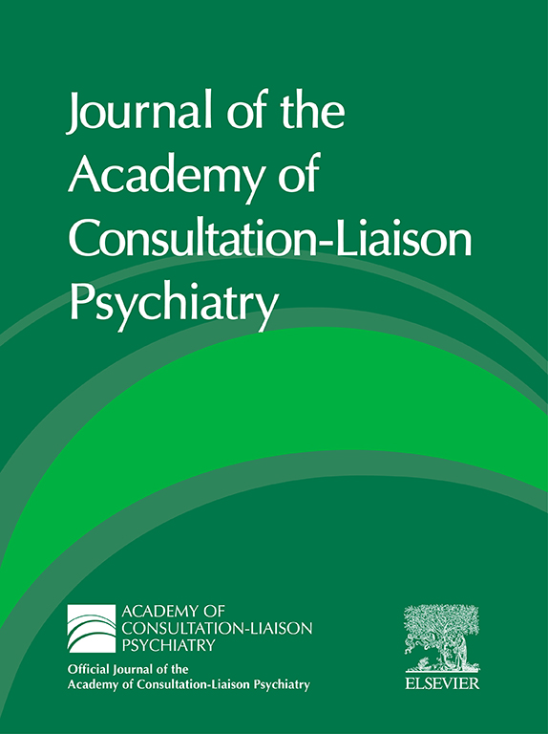
Future Directions: Journal of the ACLP
Adding DEI, anti-racism, health care disparities, and cultural and structural competencies as “particular areas of interest” in the journal’s online mission statement
Devoting special issues to the above areas
Reviewing articles for use of pronouns and non-stigmatizing, non-biased language
Assessing articles for the risk of bias and for generalizability to underserved communities

Slide 22
Link to the DEI Task Force Report
https://www.clpsychiatry.org/news/academys-dei-task-force-report-published/

Slide 23
References
Metzl JM, Hansen H. Structural competency: theorizing a new medical engagement with stigma and inequality. Soc Sci Med. 2014;103:126-133.
Neff J, Holmes SM, et al. Structural competency: a curriculum for medical students, residents, and interprofessional teams on the structural factors that produce health disparities. MedEdPORTAL. 2020 Mar 13;16:10888.

Slide 24
Thank You!

