Slide 1
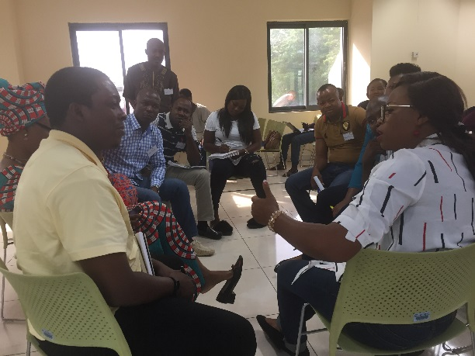
Certificate in Inclusive Insurance
A certification programme based on ten years of international experience and innovations in inclusive insurance, offered by the ILO’s Impact Insurance Facility and the College of Insurance and Financial Management.
Get certified and start developing a successful business model to serve new markets!
For more information:
contact info.cifm@gmail.com

Slide 2
Content
The Certificate in Inclusive Insurance is composed of six modules, four of which are mandatory and two which are elective (to be chosen by the candidate). Modules follow a logical order based on the value chain for an inclusive insurance product to build candidates’ knowledge and skills in a coherent way.
Mandatory modules include:
Introduction to inclusive insurance
and its business case
Market research: Translating
consumers insights into improved
results
Managing inclusive insurance
distribution
Providing insurance responsibly
Elective modules (to be confirmed) include:
Complimentary health insurance and services
Introduction to agriculture insurance
Claims management for inclusive insurance
Performance monitoring: Tracking social and financial key performance indicators
Making change happen within insurers
Certification process
To be awarded the certificate, candidates have to complete six modules (four mandatory plus two electives) and pass a final certification assignment.
Duration
All the six modules should be completed over a period of two-and-a-half years. Modules will be delivered quarterly at the CIFM, with each module lasting two to four full days (some modules are shorter than others). Dates will be informed to candidates in advance.

Slide 3
Target audience
The Certificate of Inclusive Insurance is tailored to insurance practitioners exploring, designing or wanting to improve products for emerging consumers within their organizations. It is also interesting for members of financial institutions and other distribution channels that are currently offering or interested in offering inclusive insurance products. Last, public sector and regulatory authorities willing to support inclusive and responsible insurance are also invited to take part in the programme.
What do we offer?
Highly interactive classes based on adult-learning methodologies, including group discussions, lively debates and learning exercises, role plays and games;
Case-studies and examples from the world’s leading inclusive insurance providers;
Opportunities to present the work that you are doing and discuss it with experts;
Support from CIFM and ILO trainers;
A Certificate in Inclusive Insurance recognized by the ILO’s Impact Insurance Facility and the College of Insurance and Financial Management after completing all the modules and passing the final assignment.
Are you interested?
Contact us at info.cifm@gmail.com to receive more information!

