Slide 1
Look Ahead! Smarter Transparent Displays for enhanced safety, comfort and UX
23 April 2024 / DVN Interior / Koln
Andy Travers, CEO

Slide 2
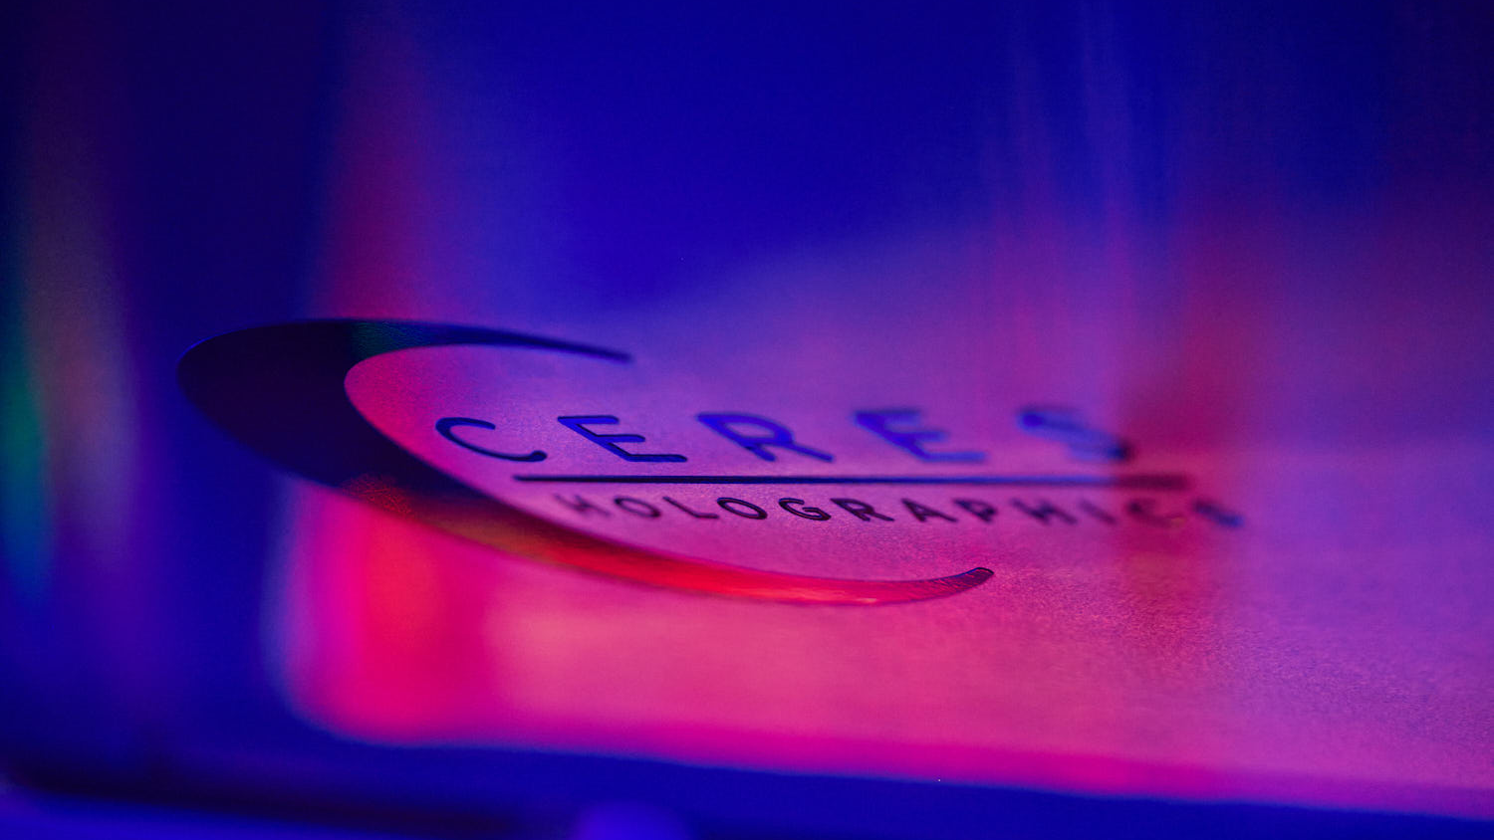
Introduction
Game-changing industrialised hologram mastering and manufacturing technology
Multi $B opportunity in holographic transparent display for automotive
Global OEMs are deeply engaged with us
Initial product validated by multiple OEMs
Multi $B opportunity is there to be shared with new and willing supply-chain partners

Slide 3
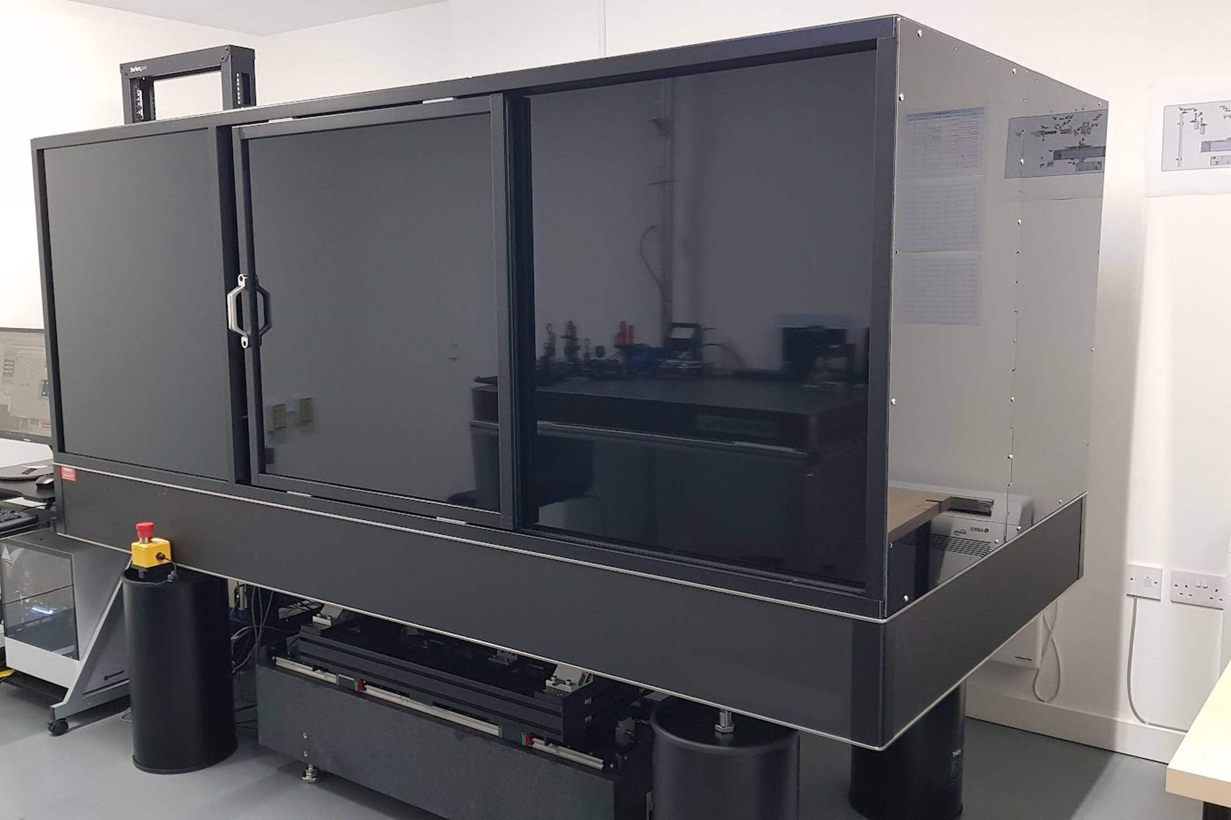
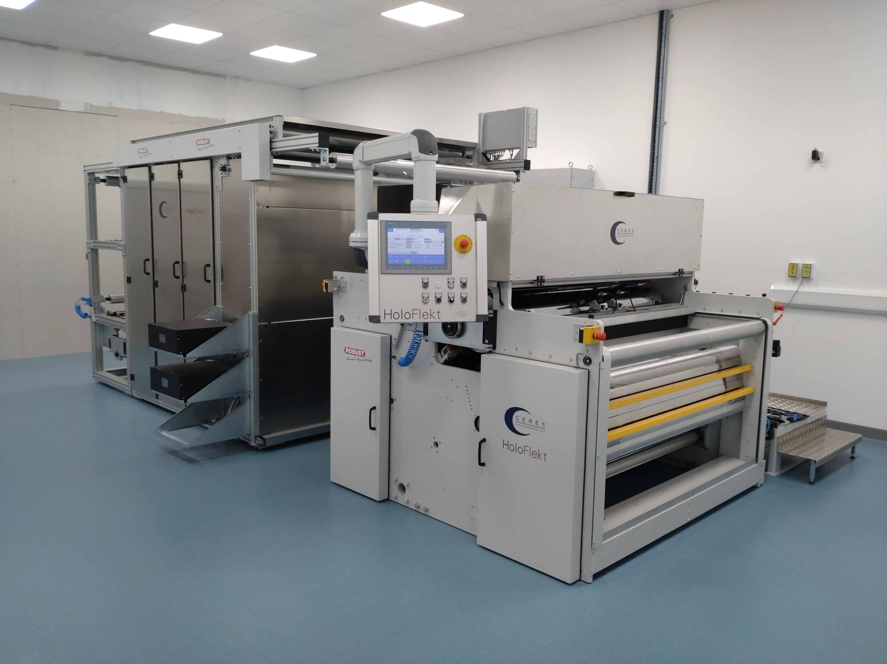
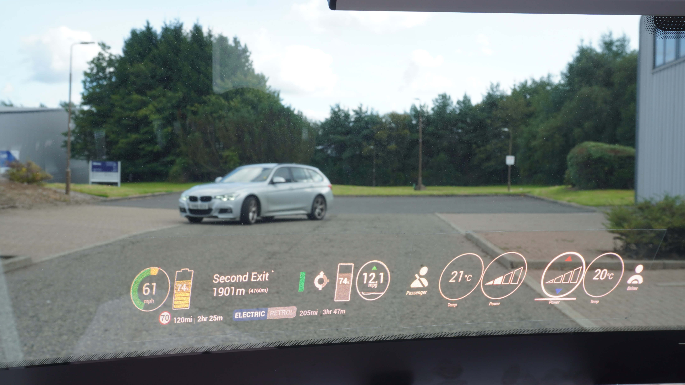
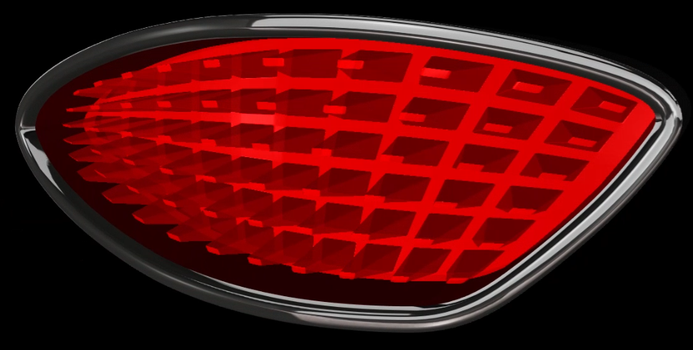
Our Capability Holographic product manufacturing - Flexibility and Scalability
Concept & Product Design
Digital Mastering
Proprietary high performance holographic master printer turns the idea into reality
Roll-to-Roll Replication
Proprietary replicator copies the master cost effectively, at high speed, to satisfy OEM volumes
Applications
Holographic optical components for future product and user experiences
Combination of Product Design, Digital Mastering and R2R processing IP gives flexible, scalable product solutions

Slide 4
Displays
Engaged with major OEMs since 2016
Transparent Display
ARHUD

Slide 5
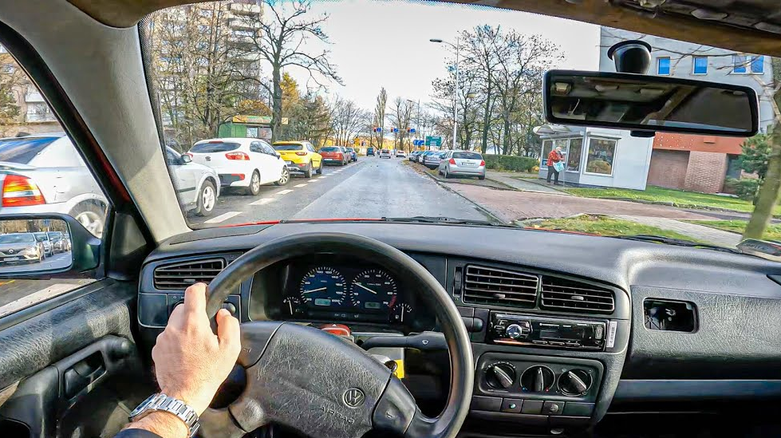
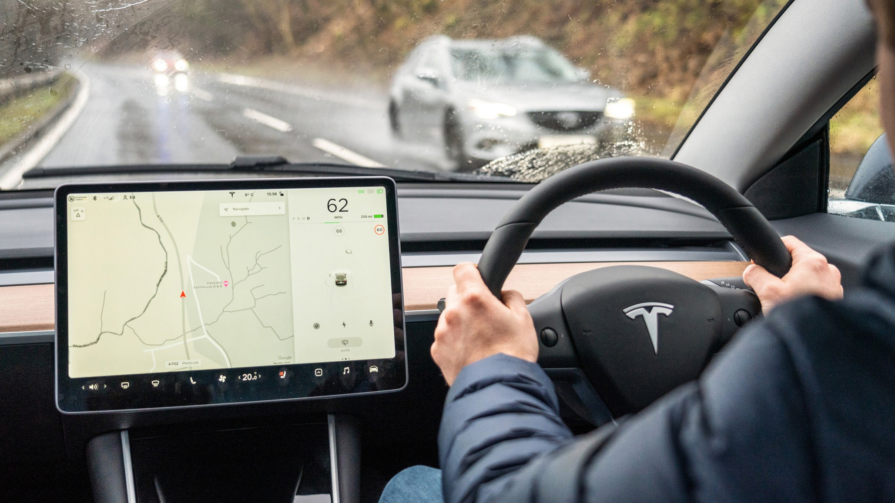
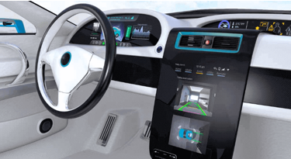
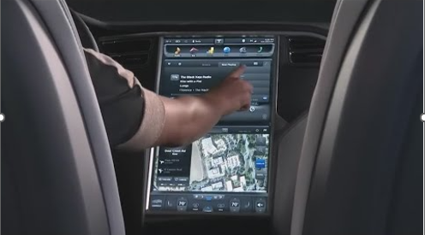
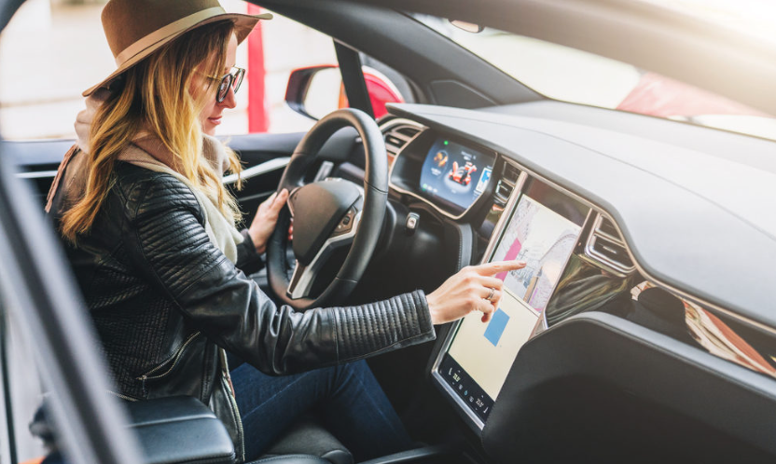
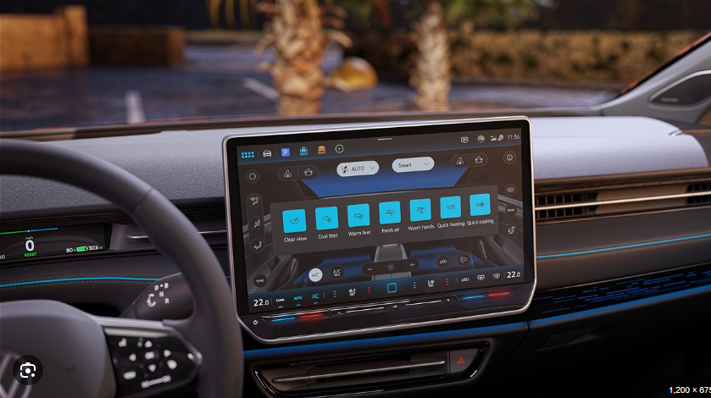
Vehicle Display and HMI experiences have evolved Touchscreens are dominating
Then - Gen 1 - Dials
Now - Gen 2 - Screens
Gen 2+ - Touchscreen Proliferation – More of them, and they are getting bigger, but are they more distracting?
BMW “DEE” CONCEPT CES2023
Notes:
Orientation to the market need

Slide 6
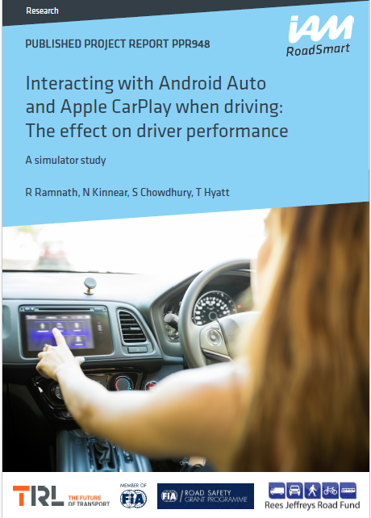
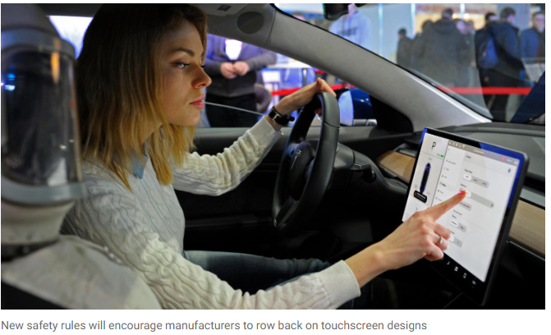
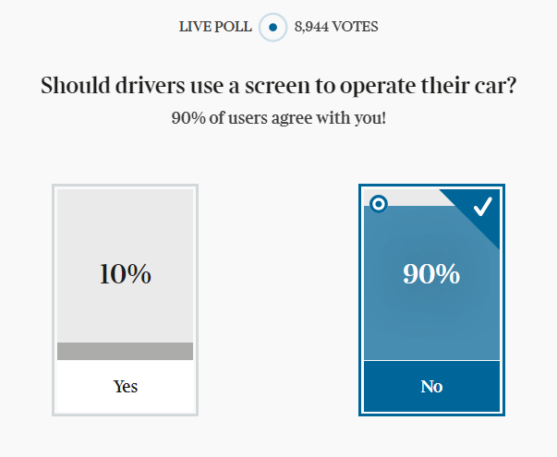
But legislation is on the horizon
“When selecting a track from Spotify drivers took their eyes of the road for as long as 20s…long enough to travel 630 metres at 116Km/hr”
“The overuse of touchscreens is an industry-wide problem, with almost every vehicle-maker moving key controls onto central touchscreens, obliging drivers to take their eyes off the road and raising the risk of distraction crashes.”
Euro NCAP
“New Euro NCAP tests due in 2026 will encourage manufacturers to use separate, physical controls for basic functions in an intuitive manner, limiting eyes-off-road time and therefore promoting safer driving.”
Matthew Avery, Director at Euro NCAP
BMW “DEE” CONCEPT CES2023
Notes:
Orientation to the market need

Slide 7
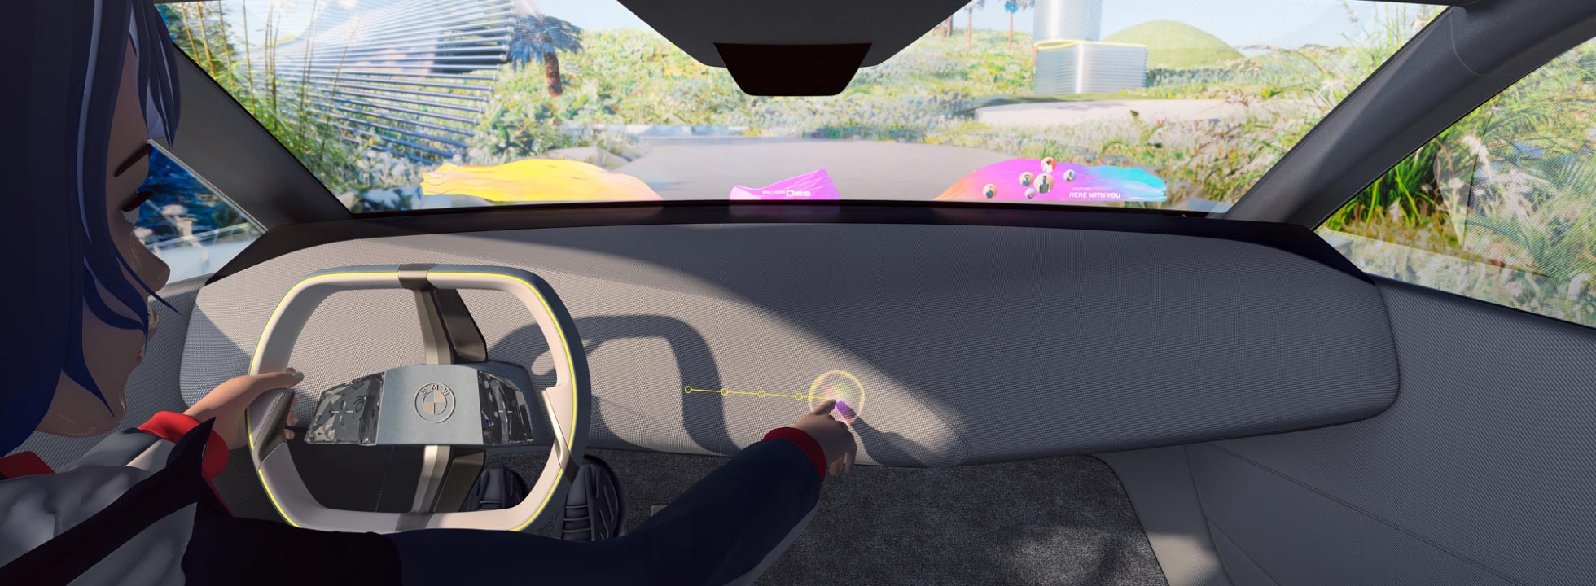
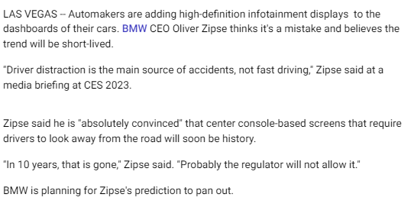
OEMs are preparing Windscreen displays are needed as part of the future solution
Future - Generation 3 - Auto Industry Vision of Windscreen Displays
Why?
Safety: Head up, eyes forward
Immersion: Large glazing elements, purposeful connected technology on demand
Comfort: Decluttered interior with no instrument cluster or distracting screens
BMW “DEE” CONCEPT CES2023
BMW “DEE” CONCEPT CES2023
Notes:
Orientation to the market need

Slide 8
Ceres have been focussed on finding a solution 8 years helping deliver OEMs future cabin experience vision
Windscreen becomes a display both in-plane (for control and infotainment) and far field (directional info)
Low profile technology
Technology is there only when needed and otherwise hidden
OEM DESIGN CONCEPT
Very large glazing surfaces and traditional technology such as dashboards minimised or eliminated
Technology will continue to grow in importance as a key differentiator for vehicle manufacturers
Car no longer solely about transportation, with onset of mass connectivity and autonomy

Slide 9
Transparent Display
23rd April 2024 DVN Interior

Slide 10
Transparent Display in Action, Driver’s View
Real Photograph
23rd April 2024 DVN Interior

Slide 11
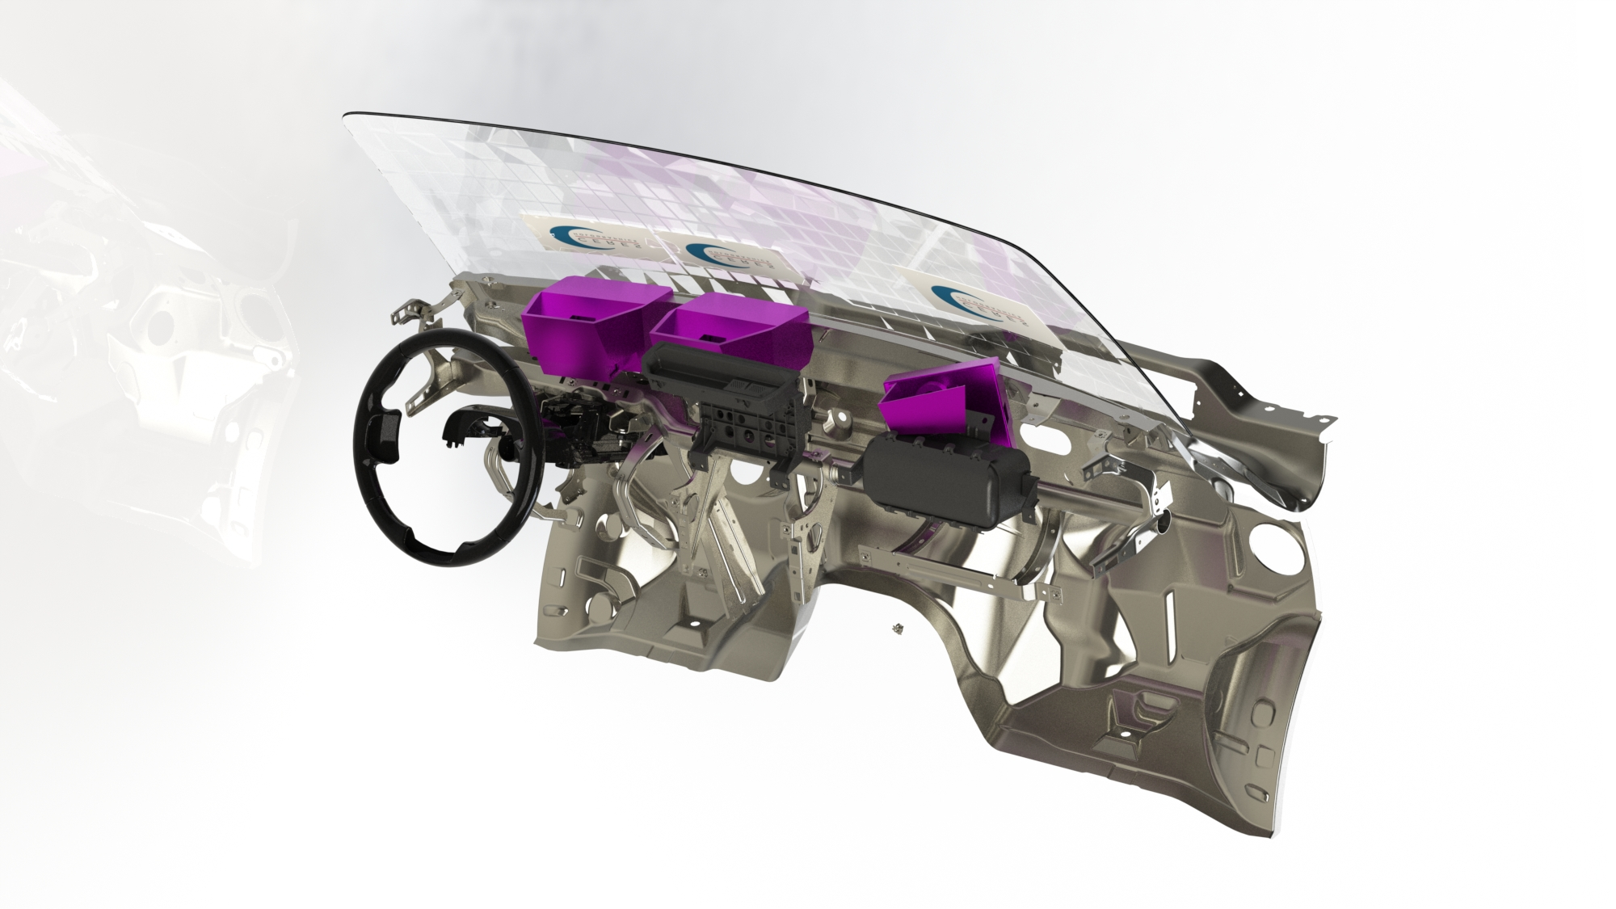
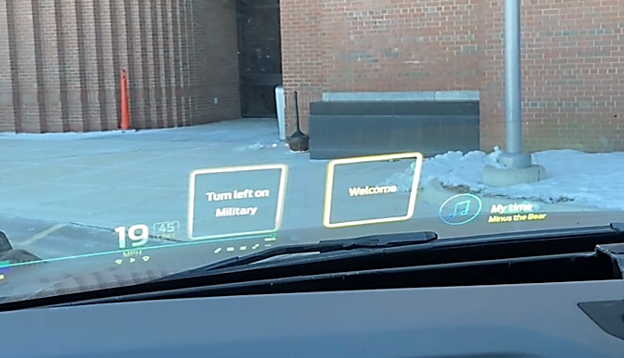
Multiple design configurations possible
High Performance Displays
Vibrant. Immersive. Safe. Under all conditions.
Full platform applicability
A fit for every vehicle
High brightness
In excess of global OEM requirements.
Very large Field of View
Immersive technology is scalable to engage the viewer.
Ease of vehicle integration
Super compact and low profile, with very flexible installation options, enabling wide adoption.

Slide 12
Manufacturing and Volume Production

Slide 13
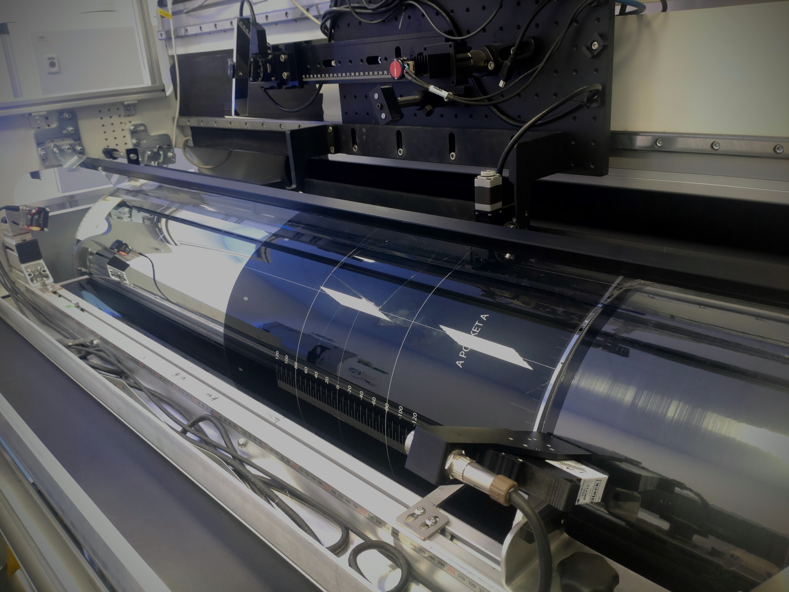
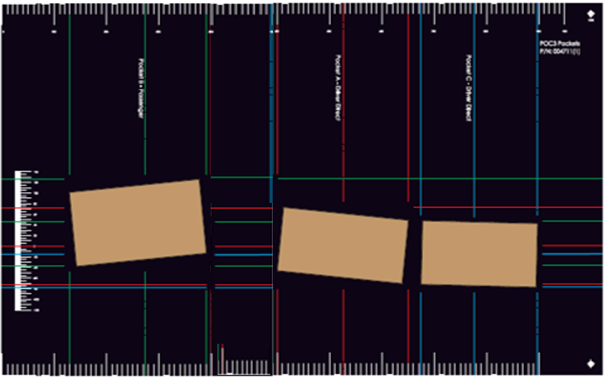
Multiple display areas produced in a single film
Each master is designed and pre-compensated for the actual position and windscreen curvature.
All masters created separately on flat glass using our software-controlled digital printer.
Each master is then positioned on the HoloFlekt® production replicator machine copy drum
Blank film loaded and fed through machine
Each master copied sequentially into full width automotive film, with alignment marks, and protected.
Masters spaced and fixed on drum

Slide 14
Windshield Lamination Proprietary photopolymer film stack and lamination process
The Challenge:
Good optical performance, safety, and cost-effective manufacturing process
5 years development by Eastman and Ceres
New photopolymer film stack created, used and tested in Ceres HoloFlekt® manufacturing machine
Final lamination process has been transferred and run successfully in auto windscreen company
Laminated windscreens are in vehicles and on the road at OEMs test facilities

Slide 15
“Ceres Holographics stand at the forefront of a new era for holography. They have delivered a number of ground-breaking advances in the way in which holograms are created in our Bayfol HX® photopolymer and can be delivered for mass-market applications.” —Dr Thomas Facke, Covestro AG

Slide 16
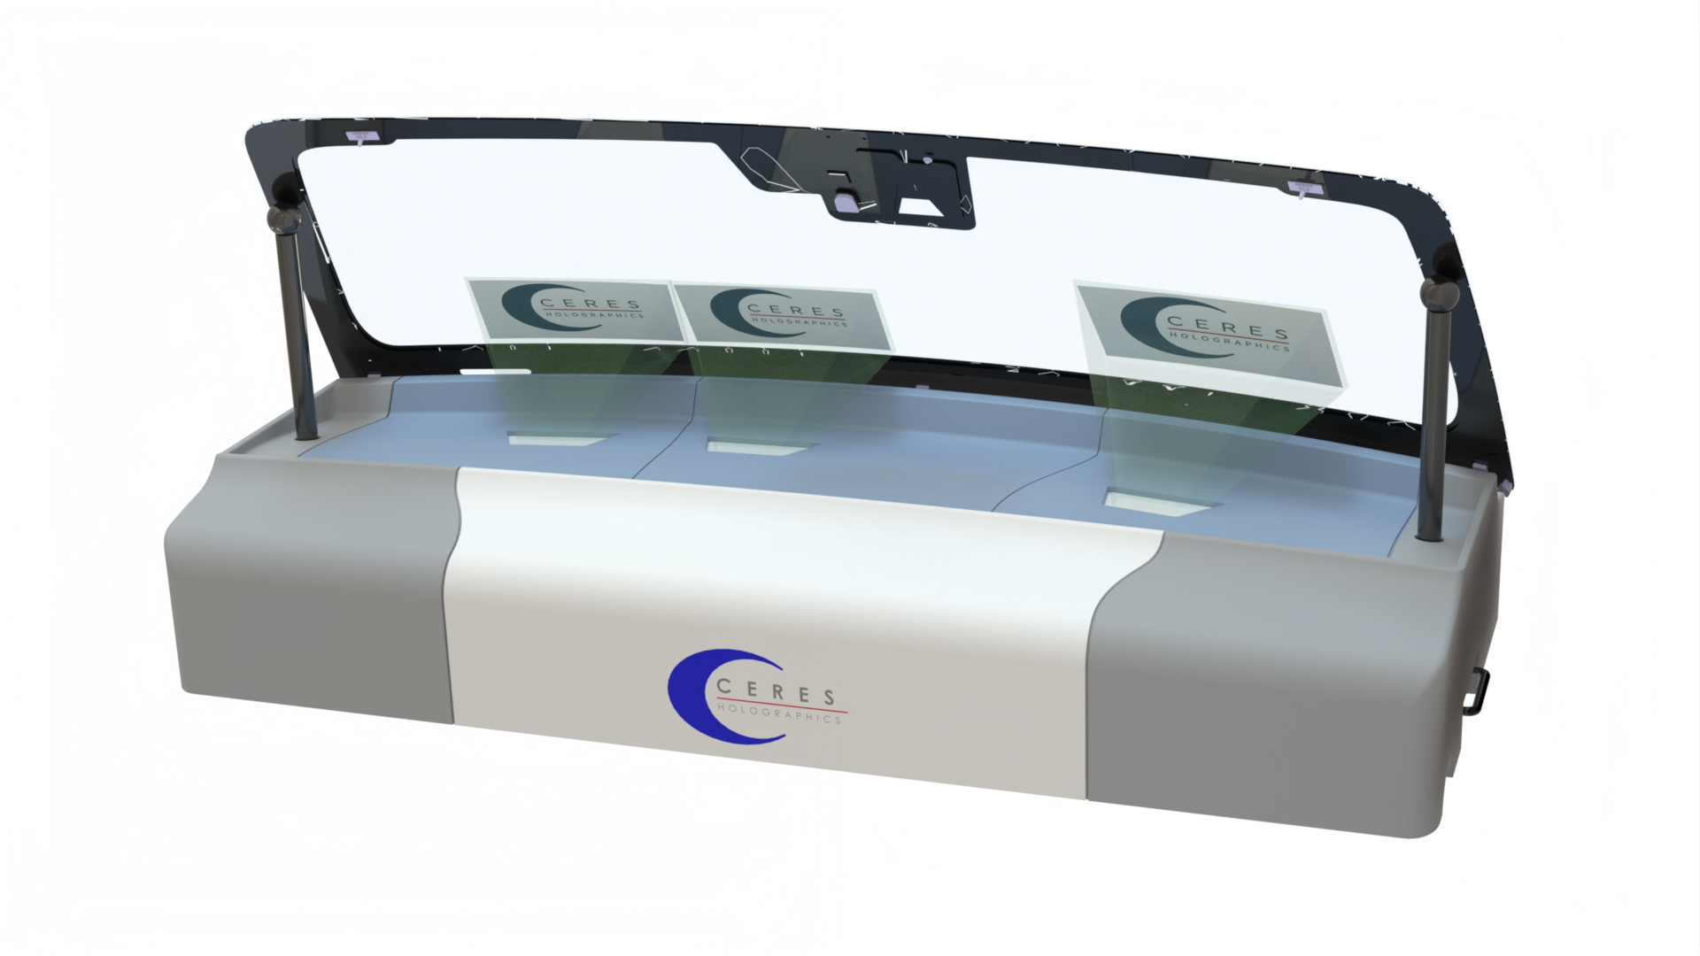
Holographic
Transparent Display
From Concept
to Manufactured Reality
Thank You
DVN Interior 2024
Exhibition Booth
Triple Display Demonstrator

