Slide 1
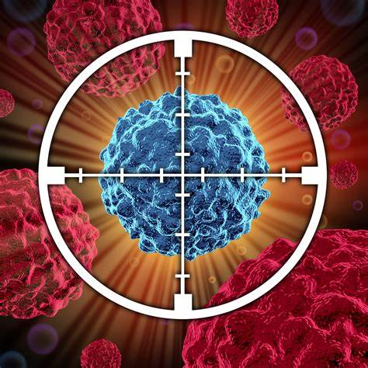
Gedeptin® License
Conference Call
Innovations in Cancer Therapy
GeoVax Labs, Inc. NASDAQ: GOVX
September 29, 2021

Slide 2
Forward Looking Statements
Certain statements in this presentation may constitute "forward-looking statements" within the meaning of the Private Securities Litigation Reform Act. These statements are based on management's current expectations and are subject to uncertainty and changes in circumstances. Actual results may differ materially from those included in these statements due to a variety of factors, including whether: GeoVax can develop and manufacture its vaccines with the desired characteristics in a timely manner, GeoVax's vaccines will be safe for human use, GeoVax's vaccines will effectively prevent targeted infections in humans, GeoVax’s vaccines will receive regulatory approvals necessary to be licensed and marketed, GeoVax raises required capital to complete vaccine development, there is development of competitive products that may be more effective or easier to use than GeoVax's products, GeoVax will be able to enter into favorable manufacturing and distribution agreements, and other factors, over which GeoVax has no control. GeoVax assumes no obligation to update these forward-looking statements and does not intend to do so. More information about these factors is contained in GeoVax's filings with the Securities and Exchange Commission including those set forth at "Risk Factors" in GeoVax's Form 10-K.
2

Slide 3
GeoVax Expands Immuno-Oncology Pipeline with
Acquisition of Clinical-Stage Cancer Program
License of Gedeptin® Adds Orphan Drug Clinical Program for
Treatment of Advanced Head and Neck Cancers
ATLANTA, GA, September 28, 2021 – GeoVax Labs, Inc. (Nasdaq: GOVX), a biotechnology company specializing in developing human vaccines and cancer immunotherapies, today announced that it has entered into an Assignment and License Agreement (the “License”) with PNP Therapeutics, Inc. (“PNP”), that grants GeoVax exclusive rights to develop and commercialize Gedeptin®, a novel patented product for the treatment of solid tumors.
The License provides exclusive worldwide rights to key intellectual property, including Gedeptin patents, know-how, regulatory filings, clinical materials, and trademarks. The patent portfolio covering Gedeptin, was originally licensed from the University of Alabama at Birmingham (UAB) and Southern Research Institute (SRI) by PNP. …
“Today’s announcement accelerates our progress within immuno-oncology, providing a pivotal clinical-stage status via the Gedeptin program. We similarly remain focused on accelerating progress related to our SARS-CoV-2 vaccine and look forward to providing further updates soon.”
3

Slide 4

The Discovery and its Uniqueness:
Tumor Death From Within
NIH funded academic studies by our group have shown that intratumoral production of a profoundly active compound leads to pronounced anticancer activity and destruction of otherwise untreatable tumors.
4

Slide 5
Chemotherapy and Radiation Treatments Frequently Fail
These modalities fail to treat the large numbers of silent, quiescent cells in a tumor mass.
The PNP technology is specifically designed to destroy these cells.
5

Slide 6
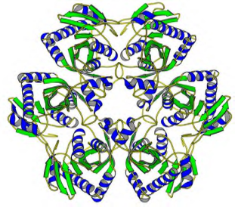
Mechanism of Action
F-araAMP (Fludara, Fludarabine phosphate)
GedeptinTM
(Ad/PNP)
Plasma enzymes
F-araA (Fludarabine)
E. coli PNP in tumor cells
Fluoroadenine
Unprecedented level of cell killing activity
Novel tumor killing mechanism
Destroys refractory solid tumors
6

Slide 7
Tumor Response When < 5% of Cells Express PNP
7

Slide 8
Powerful Aspects of the PNP Technology
  Novel tumor-killing mechanism
  Active against both proliferating and non-proliferating (stealth) tumor cells
  No significant systemic or other toxicity observed
  Additive/Synergistic with radiation therapy
  Designed to kill tumor stem cells
  May augment immunologic clearance of malignant tissues
8

Slide 9
Phase I/IIa Clinical Protocol
NCT – 01310179: Single Cycle
Standard 3+3 study design, single treatment cycle
Ad/PNP vector administered IT twice (AM/PM) on Day 1, once on Day 2
Fludarabine administered IV daily on Days 3 - 5
Cohorts 1 to 3 – Escalate fludarabine
Cohort 4 – Escalate Ad/PNP
9

Slide 10
Phase I/IIa Clinical Trial – Single Cycle
Pronounced Tumor Responses
Patient 7
Patient 8
Patient 9
Patient 10
Patient 11
Patient 12
At the high dose of F-araAMP (cohorts 3 and 4) there was substantial antitumor response
10

Slide 11
Phase I/IIa Safety Overview: Single Cycle
No Treatment-Related SAEs
 |  | Cohort 1 | Cohort 2 | Cohort 3 | Cohort 4 | Total
TEAEs |  | 3 | 3 | 3 | 3 | 12
TEAEs ≥ grade 3 |  | 2 | 3 | 1 | 1 | 7
TEAEs leading to hospitalization |  | 1 | 0 | 1 | 1 | 3
TEAEs leading to treatment termination |  | 0 | 0 | 0 | 0 | 0
TEAEs leading to death |  | 0 | 0 | 0 | 0 | 0
Treatment-emergent SAEs |  | 2 | 1 | 1 | 1 | 5
Treatment-related AEs |  | 3 | 3 | 3 | 3 | 12
Treatment-related AEs ≥ grade 3 |  | 0 | 1 | 0 | 1 | 2
Treatment-related SAEs |  | 0 | 0 | 0 | 0 | 0
Dose limiting toxicities |  | 0 | 0 | 0 | 0 | 0
 |  | TEAEs, | Treatment-Emergent Adverse Events
 |  | AEs, | Adverse Events
 |  | SAEs, | Serious Adverse Events
Treatment emergent AE/SAE is defined as an AE/SAE that occurred following initiation of study treatment, that may or may not be related to study drug
11

Slide 12
Approved Phase I/IIa Clinical Protocol – Multiple Cycles
NCT - 03754933
Utilizes dose and schedule found safe and effective in Phase I/IIa trial (as a single cycle*)
Up to 5 cycles will be administered
The entire tumor burden will be treated
* Cycle = Two days of Gedeptin followed by 3 days of fludarabine
12

Slide 13
Improves Efficacy of Check Point Blockade Inhibitors
Our recent studies indicate that PNP-based treatment may be additive or synergistic with checkpoint blockade type agents.
PNP therapy appears to robustly sensitizes tumors, that do not express E. coli PNP, to checkpoint blockade inhibitors, presumably by destroying tumor tissue at one site, exposing neoantigens, and enhancing immune response and activity of checkpoint blockade at other sites (i.e. abscopal effect).
13

Slide 14
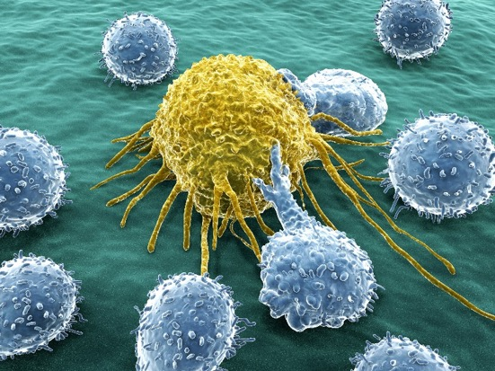
GeoVax Concept to Cancer Immunotherapy
Triple-threat Approach:
1
Tumor antigen specific immune responses induced with a vaccine
2
Immune inhibition is blocked with checkpoint inhibitors
3
Tumor cells are killed using an oncolytic agents
STIMULATE MVA-VLP with TAA to provoke immune system
BLOCK Checkpoint inhibitor to reverse immune tolerance
KILL Achieve oncolysis using Gedeptin
TUMOR REGRESSION
14

Slide 15
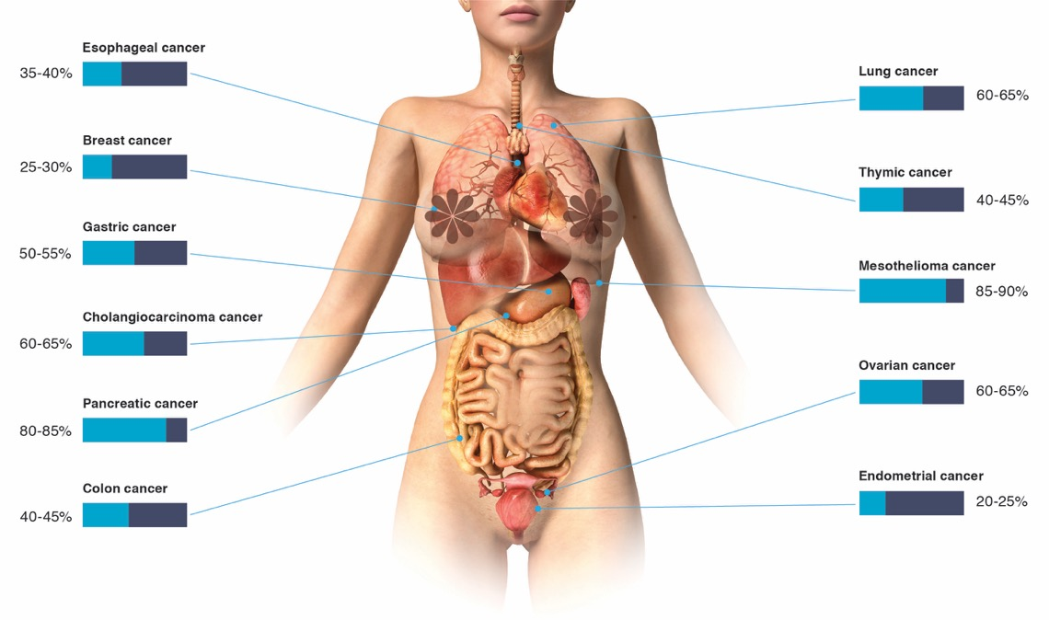
MUC1 - Cancer Immunotherapy Focus
Combination cancer vaccine strategy to utilize standard-of-care (SOC) treatments + vaccination, and immune checkpoint inhibitors (CPI) to unleash a patient’s immune system to fight cancers
GeoVax novel Cancer Immunotherapy is based on combinations of technology
  MVA-VLP cancer vaccines to induce T-cell responses
  Peptides + adjuvants to focus immune response on TAA
  Immune check-point inhibitors to unleash the immune system (Standard of care)
  Gedeptin to mediate direct tumor killing

Slide 16


Q&A Session
16

Slide 17
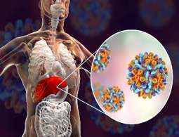

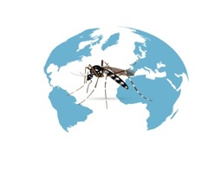
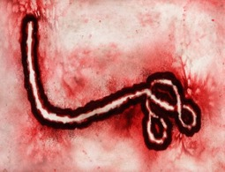


Thank You
Creating Vaccines to Serve Humanity
For More Information
GeoVax Labs, Inc.
investor@geovax.com
678-384-7220
1900 Lake Park Drive, Suite 380
Atlanta, GA 30080
Tel: (678) 384-7220
Fax: (678) 384-7281
www. geovax.com
NASDAQ: GOVX

