Slide 1
Using technology to create a better, more secure, world for all.

Slide 2
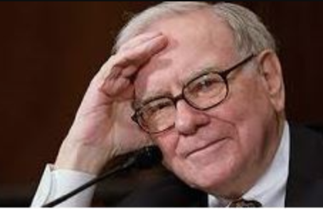
The Problem
43% of cyber attacks are aimed at small businesses, but only one-third believe they have adequate resources to manage security effectively.
Small businesses can’t afford to be attacked. 60% of small businesses that have been attacked are out of business in six months.
They need an IT/Security provider they can trust, and an increasing amount want to work with others that share their values.
“Cyber attacks is the biggest threat to mankind, even more of a threat than nuclear weapons”
- Warren Buffett

Slide 3
The Solution
We are experts in cybersecurity and fight to keep businesses safe.
We are a woman-owned public benefit corporation creating opportunities for women and other underrepresented people in tech.

Slide 4
Our Business Model
We deliver our services through:
Monthly subscriptions & retainers
Projects and consulting agreements
Reselling products & services

Slide 5
Our Market
Mission-driven and/or socially conscious companies
and
Businesses with complex data security requirements
Notes:
We protect mission-driven and/or socially conscious companies. The movement towards socially conscious business practices, including the steady rise of B Corps and Public Benefit Corporations, means an ever-increasing demand for providers whose values are aligned. We are a preferred vendor for these businesses and are well positioned to become the go-to IT Security provider for B Corps.
We also partner with businesses that have complex data security requirements or need to comply with government regulations. Government contractors and professional service providers such as doctors, lawyers, & accountants are a perfect fit for us.

Slide 6
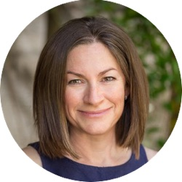
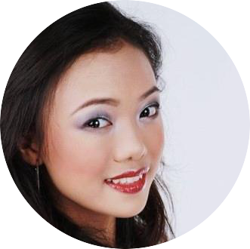
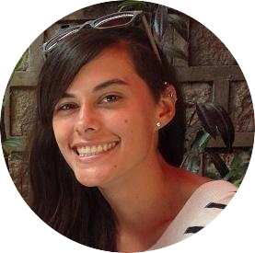
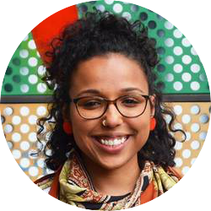
Our Team
Jenn CEO/Founder
Jason Azure/AWS
Lailanie Project Manager
Loren Chief Impact Officer
Ivellisse Marketing
Scott IT Support
Notes:
We have a unique combination of experience, skills, world-view, and a passion for making the world a better place through technology and business.
Jenn Diesi is a tech veteran and information security expert who brings 20+ years of experience protecting networks for global companies large and small. She is relentless and works tirelessly to protect others. Jenn’s experience as a successful self-taught IT professional and single mom inspired her vision to create a welcoming workplace with a meaningful mission to economically empower others.

Slide 7
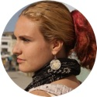
Delivery & Testimonial
“ It was clear from the start that [Jenn] is a master of her trade and keeps up-to-date on new developments in the tech field. Jenn is very responsive and full of suggestions to improve processes and make life easier for a small business like ours. She has a positive attitude and is great to work with. We highly recommend Jenn and her team to other businesses.” - Katarina W.

Slide 8
Financial Projections
Profitable in less than 3 years, and 10M in revenue by year 5
 | Year 1 | Year 2 | Year 3 | Year 4 | Year 5
Revenues | $199,800 | $665,000 | $1,968,750 | $5,304,688 | $13,740,234
Expenses | $285,200 | $770,300 | $1,191,875 | $1,685,731 | $2,635,925
Net | -$85,420 | -$105,300 | $776,875 | $3,618,957 | $11,104,309

Slide 9
Want to Know More?
Jenn Diesi
jenn@geekgirltech.com
510-205-5650

Slide 10
This is a slide title
Here you have a list of items
And some text
But remember not to overload your slides with content
Your audience will listen to you or read the content, but won’t do both.

