Slide 1
ECT for C-L Psychiatrists: An Effective Intervention That Might Save a Life
ACLP Skills Course
2021

Slide 2
CLP 2021 Disclosure: A Evan Eyler, MD, Jules Knight, MD, PhD, Karin Lewicki, MD, Amy Odefey, MD, Terry Rabinowitz, MD
With respect to the following presentation, there has been no relevant (direct or indirect) financial relationship between the party listed above (and/or spouse/partner) and any for-profit company which could be considered a conflict of interest.

Slide 3
Faculty
EE
JK
KL
AO
TR

Slide 4
Why Learn About ECT?
Academy of Psychosomatic Medicine (now ACLP) Practice Guidelines for Psychiatric Consultation in the General Medical Setting
The C-L psychiatrist must be knowledgeable about electroconvulsive therapy (ECT) and recognize when to introduce it in depressed, catatonic, or critically ill patients”(Bronheim, Fulop, Kunkel, et al; 1998)
The more you know, the more likely you are to:
Consider it
Not be afraid of it
Feel comfortable with it
Be able to identify where it should be used
It works!

Slide 5
Agenda
What | Who
Introductions, Background, Instrumentation, Technique | Rabinowitz
Basic Science of ECT & Hypothesized Mechanisms of Action | Lewicki
Work-up of the medical/surgical patient Anesthesia technique & physiological response to electrically induced seizures Role of the anesthesia provider in optimizing treatment success and preventing complications Protecting patients and treatment team from viral exposure during the COVID-19 pandemic Special considerations for evaluating candidates for ECT via telemedicine | Eyler & Odefey
Special Populations and Cases | Knight & Lewicki
Other topics as time allows: Ethical considerations Research Informed consent | All faculty & learners
Q & A | All faculty & learners

Slide 6
Details
History of ECT
Indications & Contraindications
Work-up of the patient pre-ECT
Different diagnoses/conditions in the general hospital that might benefit from ECT e.g.,
Expectant mother with life-threatening psychosis
Catatonia
Mania
Delirium
Depression with psychotic features
ECT Technique, Apparatus, and Interpretation of Seizure Morphology
Electrode placement
Where, why, how?

Slide 7
Energy
Anesthesia
Physiology
Missed or short seizures
Expected Response and Follow-up
Informed Consent & Other Legal Considerations
Emergency guardianship
Right to refuse

Slide 8
References
Practice of Electroconvulsive Therapy: Recommendations for Treatment, Training, and Privileging. (A Task Force Report of the American Psychiatric Association) 2nd ed. American Psychiatric Press Inc. 2001.
Mueller PS, Albin, SM, Barnes RD, Rasmussen, KG. Safety of Electroconvulsive Therapy in Patients with Unrepaired Abdominal Aortic Aneurysm: Report of 8 Patients. J ECT, 2009.
Mankad MV, Beyer JL, Weiner RD, Krystal AD. Clinical Manual of Electroconvulsive Therapy. American Psychiatric Publishing, Inc. 2010.
Rasmussen KG. Electroconvulsive Therapy. In Levenson JL (ed.) Textbook of Psychosomatic Medicine. Psychiatric Care of the Medically Ill. Arlington, VA, American Psychiatric Publishing, Inc., 2011; 1043-1052.
Fazzino T, Rabinowitz T, Althoff RR, Helzer JE. Monitoring Daily Affective Symptoms and Memory Function Using Interactive Voice Response in Outpatients Receiving Electroconvulsive Therapy. J ECT 2013; 29:318-324.
Sutor B, Rasmussen, KG. Clinical Challenges in Maintenance Electroconvulsive Therapy for Older Patients with Medical Comorbidity. J ECT, 2015.
Rasmussen KG. What Type of Cognitive Testing Should Be Part of Routine Electroconvulsive Therapy Practice? J ECT. 2015.
Do Patients with Personality Disorders Respond Differently to Electroconvulsive Therapy? A Review of the Literature and Consideration of Conceptual Issues. J ECT 2015; 31:6-12.
Graff V, Wingfield P, Adams D, Rabinowitz T. An Investigation of Patient Preferences for Music Played Before Electroconvulsive Therapy. J ECT, 2016.

Slide 9
Before We Start
Who learned ECT in residency training?
Who delivered ECT in residency training?
Who used it in fellowship training?
Who uses or recommends it now?

Slide 10
History
Pre-1930s limited options for psychiatric treatment
Psychotherapy, mostly
Little more than custodial care for more severe conditions
Other therapies included hydrotherapy, insulin coma, prolonged sleep therapy, and sedatives including barbiturates and chloral hydrate
No major changes until 1950s when antipsychotics and antidepressants became available
1934: Ladislas Joseph von Meduna (Hungary)
Tx’d schizophrenia with repeated, pharmacologically (e.g., IM camphor) induced seizures
Led to decrease in psychotic symptoms, esp. in patients with catatonia
Caught on in Europe and US
However, seizures were unpredictable

Slide 11
1937: Ugo Cerletti & Lucio Bini (Italy)
Electrically induced seizures
More easily induced
Better regulation
Quickly replaced chemically induced seizures as tx for schizophrenia and mood disorders
Meduna asserted that how the seizure was produced did not matter; therapeutic effect was the seizure, not the modality
Incomplete or poorly organized seizures less effective
We still don’t know the exact mechanism(s) for the effect!
But we have some ideas
Stay tuned for Dr. Lewicki!

Slide 12
Mid 1950s saw decline in use
In part due to availability of medications
Negative portrayals in the media
Increase in use some decades later and now recognized as a proven, safe, effective, and sometimes life-saving intervention
Major innovations have led to safer, more comfortable, and more predictable outcomes
Anesthesia
Oxygenation
Muscle relaxation
Seizure and VS monitoring

Slide 13
Increase in use
Maybe secondary to medication intolerance or drug refractoriness
Very rapid response
Abrams (2002) estimated 100,000 people treated in the US each year
Likely many more now
? COVID stress-related

Slide 14
Instrumentation
Two US suppliers
MECTA corp.
Produces spECTrum devices
www.mectacorp.com/home.html
Somatics, LLC
Produces Thymatron devices
http://www.thymatron.com/main_home.asp

Slide 15
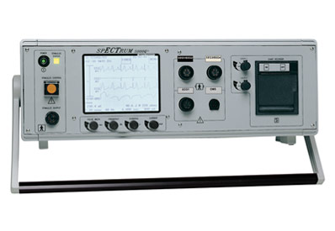
spECTrum

Slide 16
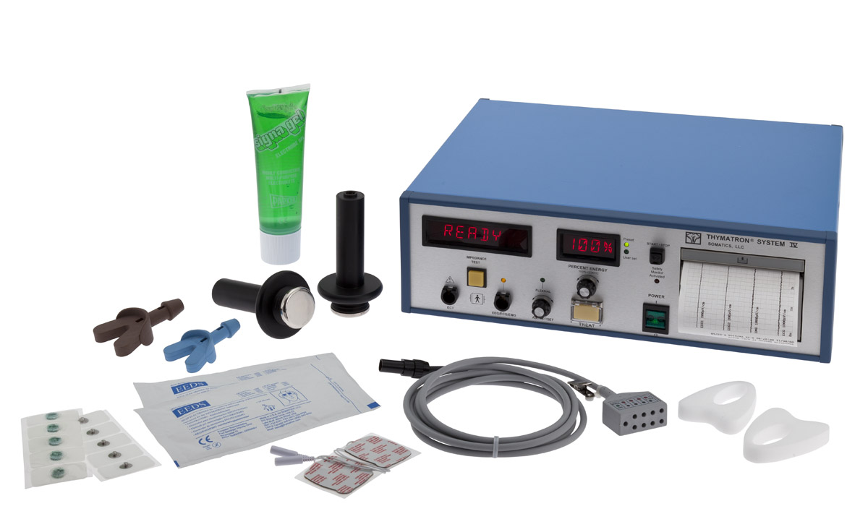
Thymatron

Slide 17
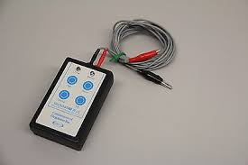
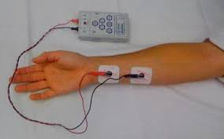
Nerve Stimulator

Slide 18
Thymatron vs. spECTrum
Both work!
Similar costs
∼$20K-$25K
Pretty easy to use
1 knob Thymatron vs. 4 knobs spECTrum
Easy dosing protocols
Pretty much maintenance free
Make sure you send back to company for service and upgrades
Not much to wear out
Consumable supplies
Chart recorder paper, EEG/EKG stickies, electrode gel
Non-consumable supplies
Bite blocks
Can be sterilized

Slide 19
Thymatron vs. spECTrum
Both work!
Similar costs
∼$20K-$25K
Pretty easy to use
1 knob Thymatron vs. 4 knobs spECTrum
Easy dosing protocols
Pretty much maintenance free
Make sure you send back to company for service and upgrades
Not much to wear out
Consumable supplies
Chart recorder paper, EEG/EKG stickies, electrode gel
Non-consumable supplies
Bite blocks
Can be sterilized

