Slide 1
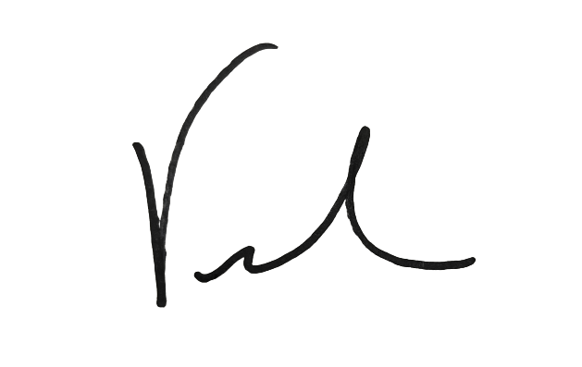
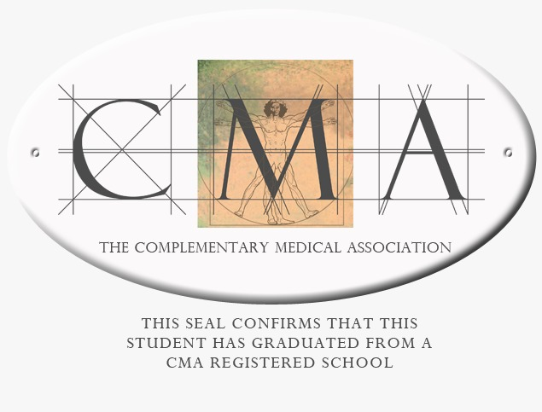
Congratulations
Certified Sound Healer: Expert Level
Vickie Gould
Life Changing Energy

