Slide 1
PCI-SIG Developers Conference
June 21-22, 2022

Slide 2
PCIe 5.0 & 6.0 & CXL 2 & 3
PCIe controller and SerDes novel modular bundle
Serdes Architecture supports Ethernet, PCIe, JESD, CPRI, USB4
Controllers validated with Avery VIP
Zero risk upgrade path leveraging silicon proven PAM4 shipping in millions of units
Easy upgrades with upfront pricing locked in for future projects and market changes

Slide 3
Modular Flexible 1-112G SerDes Architecture
1G-112G
Ethernet
Serdes
LR
ELR
1G-112G
Ethernet
Serdes
1-64G PCIe
Serdes
1G-56G
Ethernet
Serdes
1-32G PCIe
Serdes
VSR
LR
ELR
1-64G
PCIe
Serdes
1-32G
PCIe
Serdes
Drop in design – mix and match with controller options
Power & Reach optimized – to 45 dB ELR
Flexible Pricing – only pay for what is required today
Future Proof – with locked-in pricing
Available - Now for design-in

Slide 4
PCIe 5.0 & 6.0 Power Performance Area
eTopus 7/6m 1-112G Modular SerDes
PCIe Version | Power | Latency | Reach | Area
Gen 5 | <315 mW | medium 1G clk | up to 35 dB | Under NDA
Gen 6 | <350 mW | Low – 2G clk | Up to 35dB | Under NDA
Gen 7 | TBD | TBD | TBD | Under NDA
Supported – PCIe Gen 5 RC, EP & DP
Supported – CXL 2 and CXL 3
In Development – PCIe Gen 6 RC, EP & DP

Slide 5
Modular Low Power 1-64G SerDes Architecture
1G-56G
Ethernet
Serdes
LR
ELR
1G-56G
Ethernet
Serdes
1-64G PCIe
Serdes
1G-56G
Ethernet
Serdes
1-32G PCIe
Serdes
VSR
LR
LR
1-64G
PCIe
Serdes
1-32G
PCIe
Serdes
Drop in design – mix and match with controller options
Power & Reach optimized – to 35 dB LR
Flexible Pricing – only pay for what is required today
Future Proof – with locked-in pricing
Available – Q4 for design-in

Slide 6
PCIe 5.0 & 6.0 Power Performance Area
eTopus 7/6m 1-64G LP Modular SerDes
PCIe Version | Power | Latency | Reach | Area
Gen 5 | <300mW | medium 1G clk | up to 35 dB | Under NDA
Gen 6 | <325 mW | Low – 2G clk | Up to 35dB | Under NDA
Gen 7 | TBD | TBD | TBD | Under NDA
Supported – PCIe Gen 5 RC, EP & DP
Supported – CXL 2 and CXL 3
In Development – PCIe Gen 6 RC, EP & DP

Slide 7
Key Items to Consider When Choosing a PCIe Partner
World leader in Ethernet now supporting PCIe Gen 5 & 6, CXL 2 & CXL 3
PCIe standards are now evolving and being deployed rapidly – eTopus is ready
With proven 7nm and 6nm technology support – Market sweet spot
Bundling Controller & SerDes – lower risk and dev costs, and faster time to market
Fixed costs to upgrade to newer Controller / SerDes @ 7/6nm as needed
Customers can now start with Gen 5 and as needed low-cost upgrade to Gen 6 with same SerDes & interfaces – Eliminate both financial & technical risks
Customer centric support model to assure success

Slide 8
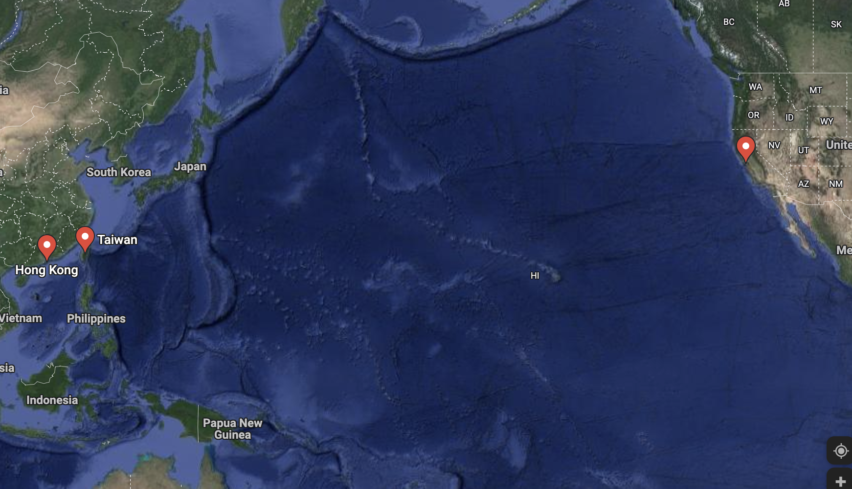
Worldwide Support & Contacts
HQ: 2870 Zanker Road, San Jose, USA
Design Support: Hong Kong & Taipei
www.etopus.com
Contact us: sales@etopus.com

Slide 9
Thank you!!
More Info: sales@etopus.com

