Slide 1
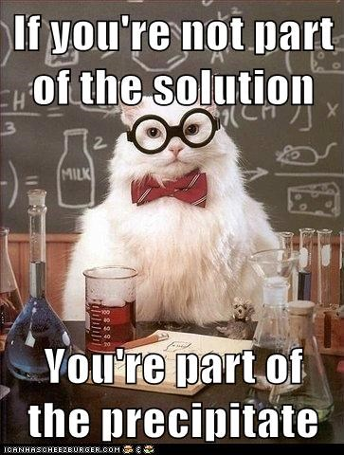
Solutions
Alcohol is never the solution
(It’s a pure substance)

Slide 2
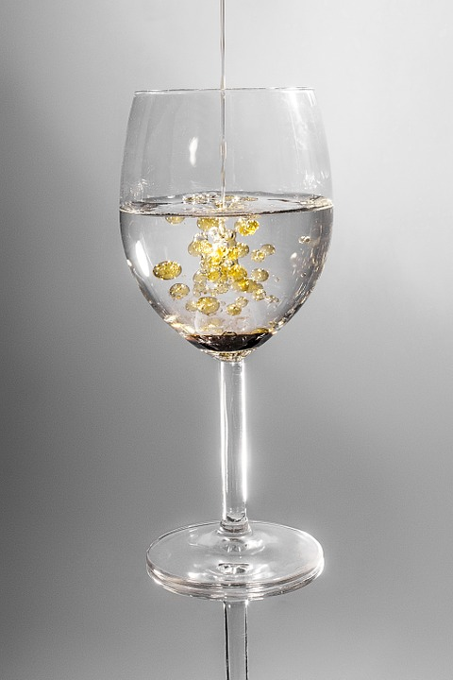
What characteristics of solute and solvent forms a solution?

Slide 3
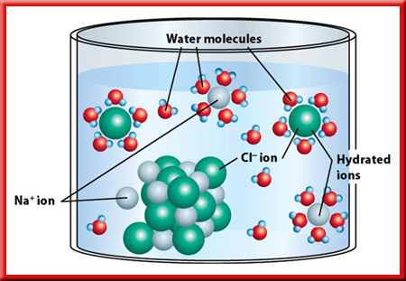
Solvation (Hydration if the solvent is water.)
Solute particles are surrounded by solvent particles.

Slide 4
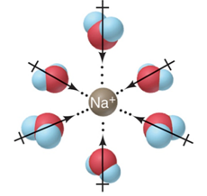
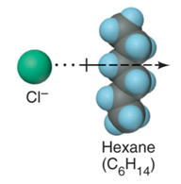
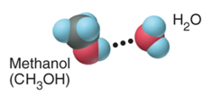
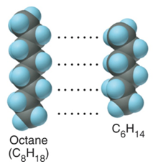
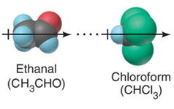
Types of intermolecular forces in solutions.
(Values are attractive force in kJ/mol)
Ion-dipole
(40-600)
Ion-induced dipole
(3-15)
H bond
(10-40)
Dipole-induced dipole
(2-10)
Dispersion
(0.05-40)
Dipole-dipole
(5-25)

Slide 5
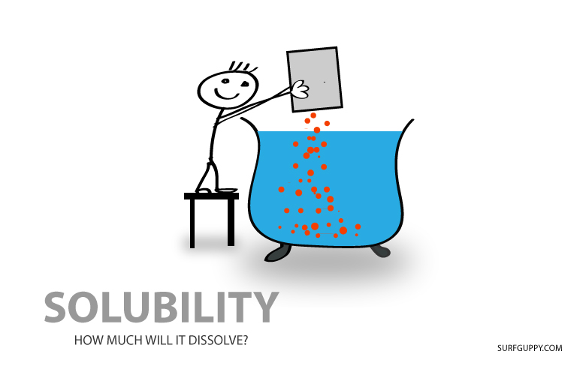

Slide 6
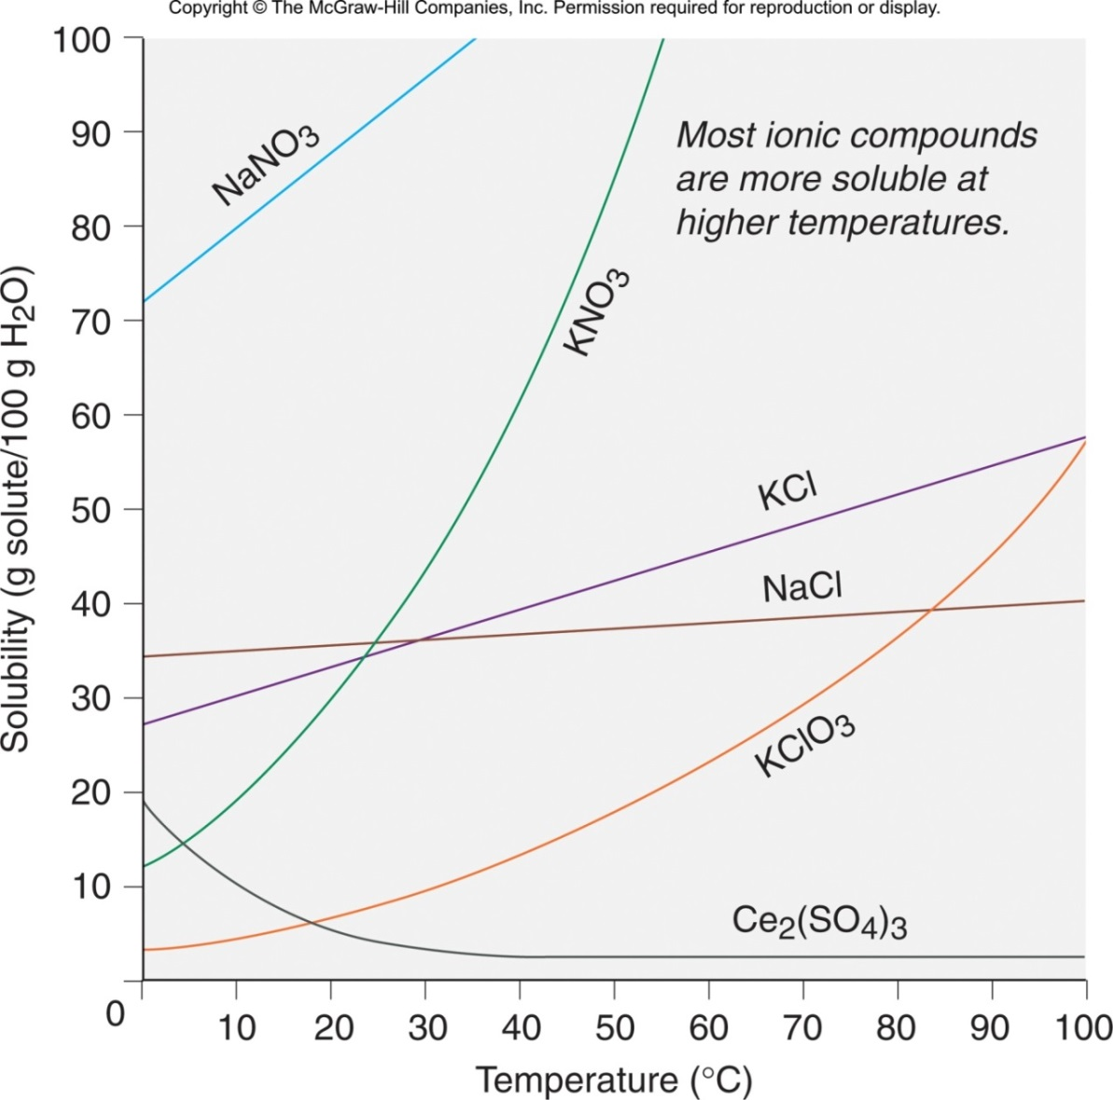
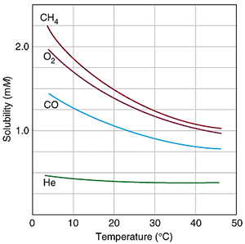
Solubility and temperature for several ionic compounds.
Solubility and temperature for several gases.

Slide 7
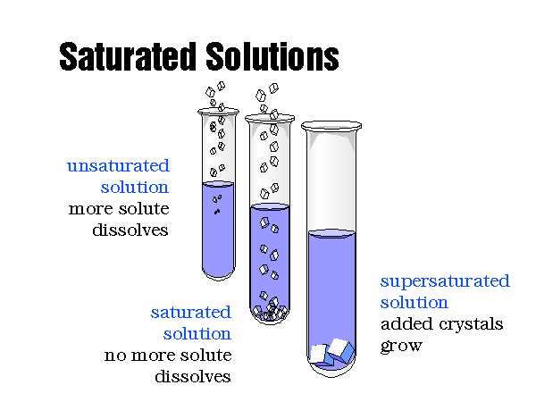

Slide 12
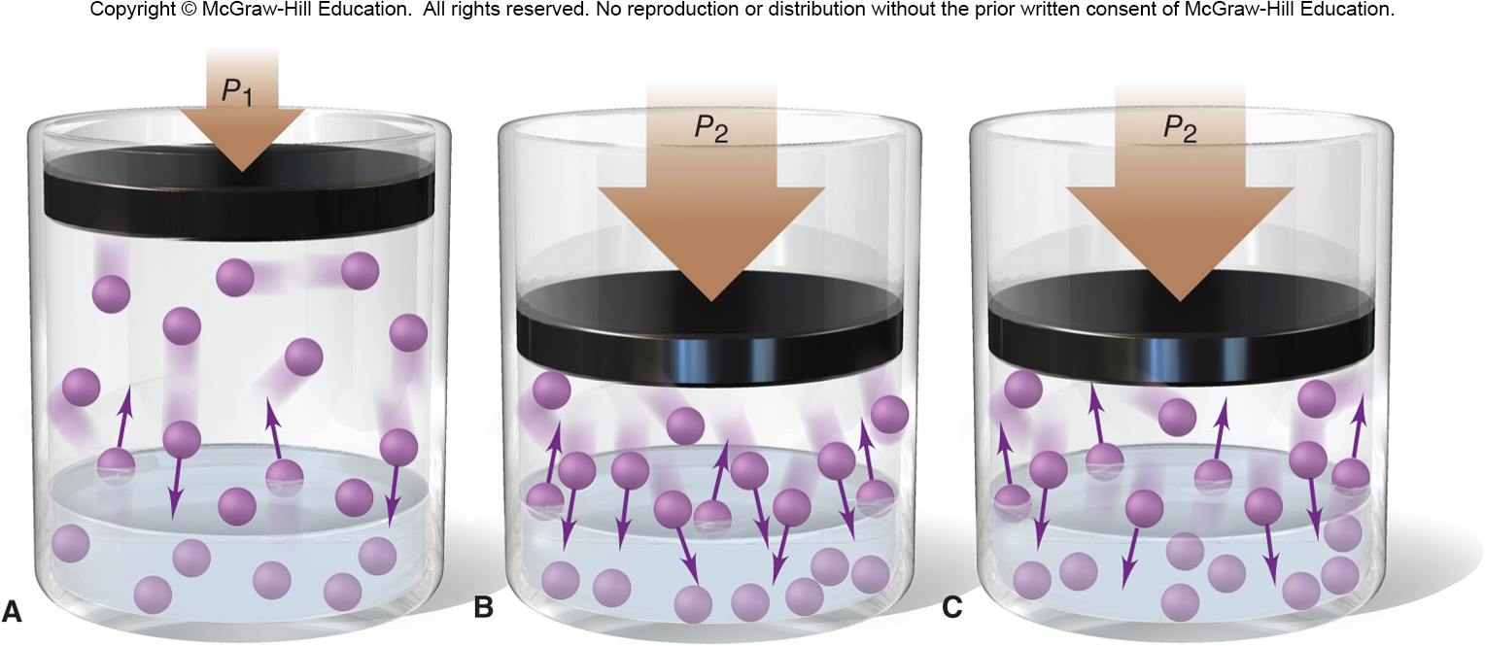
Increasing the partial pressure of a gas increases its solubility.
As the pressure is increased, more gas particles collide with the liquid surface. More gas particles work their way into the liquid until equilibrium is re-established.

Slide 13
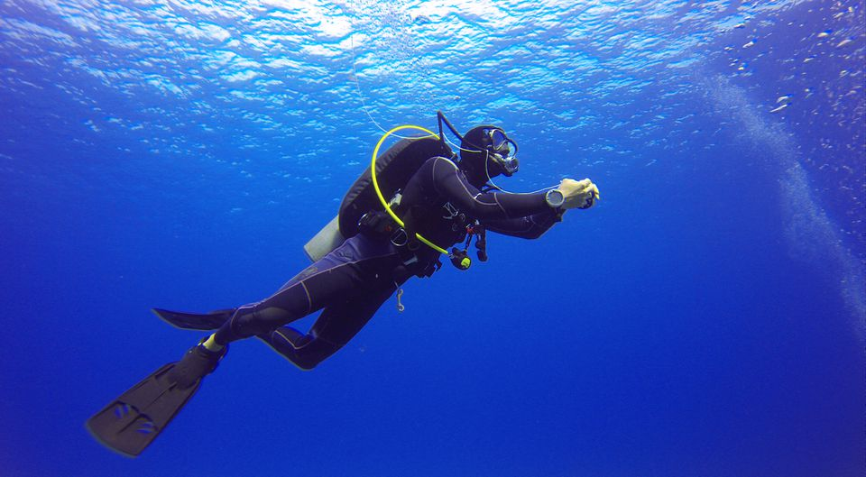
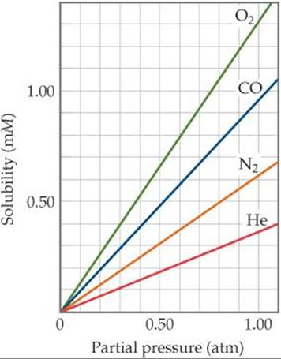
Henry’s Law
The solubility of a gas (S_{gas}) is directly proportional to the partial pressure of the gas (P_{gas}) above the solution.
S_{gas} = k_{H} x P_{gas}

