Slide 1



SYST-05:
Phase 2 Study of VAL-083 and Radiotherapy in Newly Diagnosed MGMT-unmethylated GBM
Zhong-ping Chen, MD, PhD.
Department of Neurosurgery/Neuro-oncology
Sun Yat-sen University Cancer Center, Guangzhou, China

Slide 2
Conflicts of Interest
This study has been financially supported through a SYSUCC Institutional Grant for Clinical Scientists and Kintara Therapeutics, Inc.
There are no conflicts of interest relating to the Study Team

Slide 3
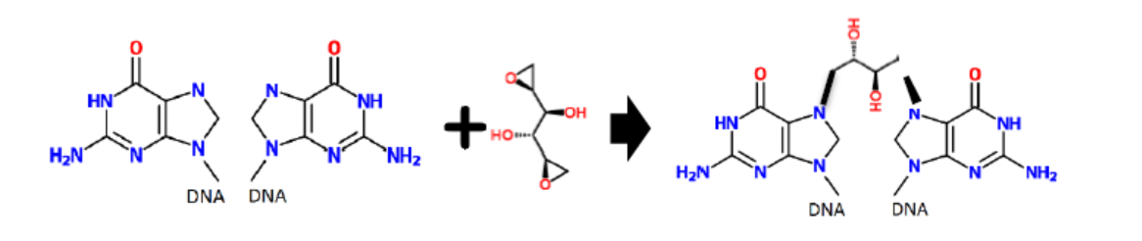

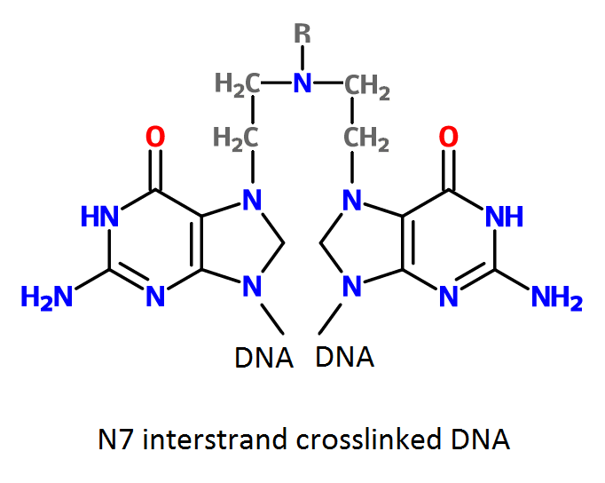
VAL-083 (Dianhydrogalactitol)
VAL-083
VAL-083 is able to overcome TMZ-resistance in GBM, in vitro and in vivo and it acts as a radio-sensitizer against GBM cancer stem cells in vitro ^{(Fouse et al, 2014)}
Historical studies have shown VAL-083 in combination with radiotherapy increased patient survival versus radiotherapy alone (Eagan et al, 1979)
The benefit of VAL-083 in combination with radiotherapy was similar to or greater than other DNA-targeting agents ^{(Eagan et al, 1979)}
2 guanine bases on DNA
VAL-083 – interstrand crosslink (ICL)
VAL-083 is a novel bi-functional DNA targeting agent that rapidly induces interstrand cross-links at N7-guanine, leading to DNA double-strand breaks (DSBs) and ultimately cell death (Zhai et al, 2018)
Me
temozolomide converts to active state (MTIC) at physiological pH
guanine base on DNA
alkylation of O6 guanine
VAL-083 in combination with radiation therapy may offer a treatment alternative against GBM tumors with MGMT-mediated resistance to chemotherapeutic agents, including TMZ and nitrosoureas.
Mechanism of temozolomide (TMZ) via alkylation at O6 of guanine
VAL-083 circumvents MGMT-mediated chemoresistance and differentiates it from other therapies used in the treatment of GBM, including TMZ (Zhai, et al, 2017, Golebiewska et al, 2020)

Slide 4
DLM-14-001 Study Design
An open label, single-arm, biomarker-driven, Phase 2 study of VAL-083 and radiation therapy in patients with newly diagnosed MGMT-unmethylated GBM .
(Clinicaltrials.gov identifier NCT03050736), (SYSUCC Ethics Committee Approve No： B2016-058-01)
VAL-083 intravenous infusion on days 1, 2, 3 of a 21-day cycle, combined with radiotherapy (2Gy/day x 5 days) for 6 weeks followed by up to 8 cycles of VAL-083 maintenance therapy.
Dose-escalation phase – cohorts at 20, 30, 40 mg/m²/day IV, to confirm maximum tolerated dose
Expansion phase – 20 additional subjects at MTD (30 mg/m²/day)

Slide 5
Endpoints
Dose escalation phase – safety, tolerability and activity (as for the expansion phase)
Expansion phase
Primary
  Progression free survival (PFS)
    Compared to historical references to temozolomide at 5.3 months¹ and 6.9 months²
Secondary
  Overall survival (OS)
  Pharmacokinetic assessments of VAL-083 in plasma and cerebrospinal fluid
  Safety and tolerability
¹Hegi et al N Eng J Med 352; 997-1003 (2005); ²Tanguturi SK, et al. NeuroOncol. 19(7): 908-917 (2017)

Slide 6
Patient Overview
Demographics
Key Inclusion Criteria
Newly diagnosed histologically proven supratentorial GBM
MGMT gene promoter status – unmethylated
Interval of >2 weeks but <7 weeks after surgery before first dose of VAL-083
Karnofsky Performance Score (KPS) >70%
Stable or decreasing dose of steroids for >5 days prior to treatment
Key Exclusion Criteria
Prior chemotherapy within the last 5 years.
Prior radiation therapy of the head.
Receiving concurrent investigational agents or has received an investigational agent within the past 30 days prior to the first dose of VAL-083
Prior systematic anti-angiogenic therapy
Placement of carmustine implant at surgery.
 |  | Starting Dose of VAL-083 (mg/m²/day)
 | All subjects (N = 29) | 20 (N = 1) | 30 (N = 25) | 40 (N = 3)
Age (years) Mean ± SD | 50.1 ± 12.7 | 33.9 - | 51.3 ± 13.1 | 46.0 ± 4.4
Sex Male | 18 (62.1%) | 1 (100%) | 15 (60.0%) | 2 (66.7%)
BSA (m²) Mean ± SD | 1.70 ± 0.17 | 1.64 - | 1.70 ± 0.16 | 1.70 ± 0.27
KPS Median (range) | 90 (70 - 100) | 90 (-) | 90 (80 - 100) | 80 (70-80)
Surgery to first dose of VAL-083 mean ± SD (days) | 36.5 ± 8.2 | 28 - | 37.6 ± 8.1 | 29.7 ± 5.5
Diagnosis to first dose of VAL-083 mean ± SD (days) | 24.8 ± 8.9 | 14 - | 25.8 ± 8.9 | 20.7 ± 7.0

Slide 7
Safety
Dose escalation cohorts evaluating doses of 20, 30 and 40 mg/m²/day on days 1, 2 and 3 of a 21-day cycle
  Myelosuppression was observed at 40 mg/m²/day
Expansion phase - VAL-083 at 30 mg/m²/day on days 1, 2 and 3 of a 21-day cycle.
Adverse Events | Serious Adverse Events | Dose Limiting Toxicities
Adverse event profile consistent with prior studies | SAEs possibly related to VAL-083 in 3/29 (10.3% subjects) | DLTs in first 2 cycles of treatment in 3/29 (10.3%) of subjects
Most common adverse events: myelosuppression and anemia | Thrombocytopenia (2) Liver disorder | One subject experienced a DLT at (1/3; 33%) at 40 mg/m²/day
Hematological adverse events generally resolved spontaneously |  | Two subjects experienced a DLT at (2/25; 8%) at 30 mg/m²/day 1 DLT was hematological 1 DLT non-hematological

Slide 8
Concentration of VAL-083 in Plasma and Cerebrospinal Fluid (CSF)
Dose (mg/m²/d) | N | T1/2 (hr) | Plasma C_{max} (ng/mL) | Plasma AUC (ng.h/ml)
20 | 1 | 0.91 - | 481.0 - | 664.5 -
30 | 25 | 0.81 ± 0.20 | 746.2 ± 149.4 | 853.2 ± 305.2
40 | 3 | 0.85 ± 0.14 | 898.7 ± 69.6 | 1041.9 ± 119.10
T_{1/2}=0.83 hr
Dose (mg/m²/d) | N | Plasma conc. 2 hr post-dose (ng/mL) | CSF conc. 2 hr post dose (ng/mL) | Ratio @ 2 hr CSF/Plasma
20 | 1 | 110.0 | 154 | 1.40
30 | 25 | 107.84 ± 16.65 | 127.09 ± 26.24 | 1.24 ± 0.35
40 | 3 | 169.7 ± 41.9 | 189.67 ± 69.89 | 1.13 ± 0.41
Overall, concentration of VAL-083 at least as high in CSF as in plasma at 2 hours after end of infusion.
Confirmed ability of VAL-083 to reach therapeutic target.

Slide 9
Best Response assessed prior to start of cycle 4
All patients with measurable tumor at baseline
(patients received (median=9) cycles
Best Response Pre C4 | N | PD | SD | CR | Discontinued/ Death
Overall | 24 | 2 (8.3%) | 13 (54.2%) | 7 (29.2%) | 2 (8.3%)
20 mg/m²/day | 1 | 1 (100%) | 0 (0%) | 0 (0%) | 0 (0%)
30 mg/m²/day | 20 | 1 (5.0%) | 12 (60.0%) | 5 (25.0%)* | 2 (10.0%)
40 mg/m²/day | 3 | 0 (0%) | 1 (33.3%) | 2 (66.7%) | 0 (0%)
* At 30 mg/m²/day, including patients with below measurable level (BML) tumor, a total of 10 patients (10/25; 40%) were assessed as CR

Slide 10
Best Response at Prior to Start of Cycle 4
Patients who Received <10 Cycles of VAL-083
 | N | PD | SD | CR | Discontinued/ death | PFS/OS
Overall | 15 | 2 (13.3%) | 9 (60.0%) | 2 (13.3%) | 2 (13.3%) | 6.0/
20 mg/m²/day | 1 | 1 (100%) | 0 (0%) | 0 (0%) | 0 (0%) | 3.0/9.5
30 mg/m²/day | 13 | 1 (7.7%) | 9 (6.9%) | 1 (7.7%) | 2 (15.4%) | 6.0/12.0
40 mg/m²/day | 1 | 0 (0%) | 0 (0%) | 1 (100%) | 0 (0%) | 31.2*/31.2*
Patients who Received >10 Cycles of VAL-083
 | N | PD | SD | CR | Discontinued/ death | PFS/OS
Overall | 14 | 0 (0%) | 4 (28.6%) | 10 (71.4%) | 0 (0%) | 12.5/22.4
20 mg/m²/day | 0 | 0 (0%) | 0 (0%) | 0 (0%) | 0 (0%) | -/-
30 mg/m²/day | 12 | 0 (0%) | 3 (25.0%) | 9 (75.0%) | 0 (0%) | 14.0/22.3
40 mg/m²/day | 2 | 0 (0%) | 1 (50%) | 1 (50%) | 0 (0%) | 9.3/22.4

Slide 11
Median Progression Free Survival (PFS)
Progression Free Survival (PFS) from diagnosis (Grade IV), censored at last known date with no disease progression (Cut-off 30thJune, 2021)
 | Starting Dose of VAL-083
 | Overall (N=29) | 20 mg/m²/d (N=1) | 30 mg/m²/d (N=25) | 40 mg/m²/d (N=3)
Median PFS (months) (95%CI) | 9.3 (6.4-12.0) | 3.0 - | 8.7 (6.4-12.5) | 9.9 (9.3-9.9)
Number Progressed (%) | 22 (75.9%) | 1 (100%) | 19 (76.0%) | 2 (66.7%)
Reference Data: 5.3 (95%CI: 5.0-7.6) months (Hegi et al (2005) N Eng J Med 352; 997-1003)
6.9 (95%CI: 5.0-12.5) months (Tanguturi SK, et al. (2017) NeuroOncol. 19(7): 908-917)

Slide 12
Median Overall Survival (OS)
Overall Survival (OS) from diagnosis (Grade IV), censored at last known date alive (Cut-off 30thJune, 2021)
 | Starting Dose of VAL-083
 | Overall (N=29) | 20 mg/m²/d (N=1) | 30 mg/m²/d (N=25) | 40 mg/m²/d (N=3)
Median OS (months) (95%CI) | 19.6 (14.0-22.4) | 9.5 - | 19.1 (12.0-22.3) | 32.3 -
Number of deaths (%) | 18 (62.1%) | 1 (100%) | 15 (60%) | 2 (66.7%)
Reference Data: 12.7 (95%CI: 11.6-14.4) months (Hegi et al (2005) N Eng J Med 352; 997-1003)
16.0 (95%CI: 9.1-28.7) months (Tanguturi SK, et al. (2017) NeuroOncol. 19(7): 908-917)

Slide 13
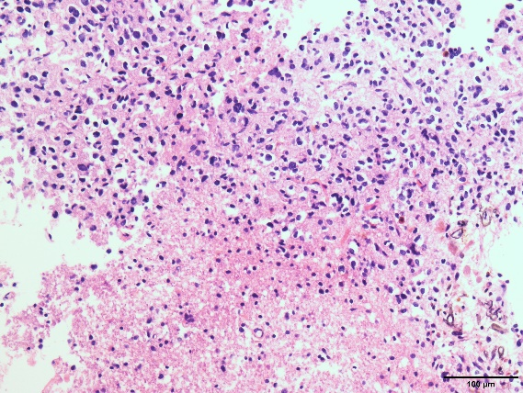
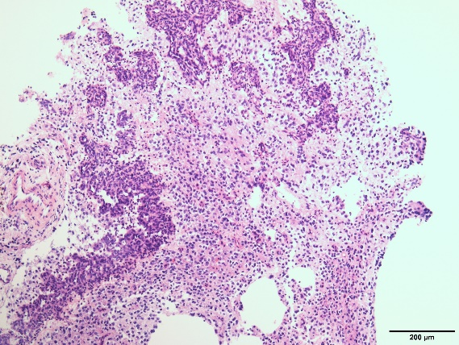
Case
HTC, Female, 32yrs
2018/May/28 Resection of Right temporal lobe tumor
Pathology: GBM，WHO IV, GFAP(+), Olig-2（+)，IDH1(-), P53(30%+),ATRX(+), MGMT(+), Ki-67(15%+), 1p19q no del，IDH1 WT；IDH2 WT.
MGMT unmethylated

Slide 14
Case – Treatment and Outcome
病例基本介绍
Chemoradiation between 2018/Jul/17 and 2018/Aug/28：
  RT 60GY/42d/30F, VAL-083 for 2 cycles (30 mg/m²/day，D1-3,Q21D）
Adjuvant Therapy from 2018/Sept/12 to 2019/Apr/17：
  VAL-083 for 11 cycles
    30 mg/m²/day, D1-3,Q21D for 9 cycles
    20 mg/m²/day, D1-3,Q21D for 2 cycles
Adverse Events: Grade Ⅱ Myelosuppression
2021/June/8: Tumor MRI (RANO): Complete Response (CR)
        PFS: 37 months
        OS: 37 months

Slide 15
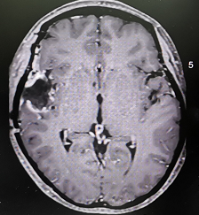
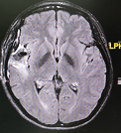
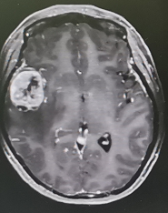
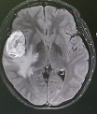
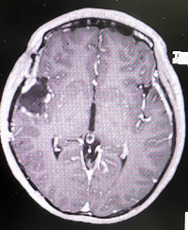
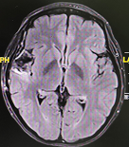
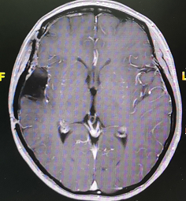
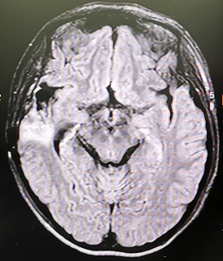
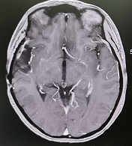
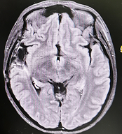
20180525 Before Surgery
20180706 Before Val-083
2018012 VAL083*3
201900514 VAL083*13
20210608 Last Follow-up

Slide 16

What we learned from this study
Is VAL-083 safe (at which dose, how many cycles) in combination with radiation therapy in newly diagnosed GBM?
Does VAL-083 improved prognosis for MGMT-unmethylated GBM as first line chemotherapy?

Slide 17
Summary and Conclusions
VAL-083 at 30 mg/m²/day in combination with radiation therapy is generally safe and well-tolerated, and multiple treatment (median=9) cycles in the adjuvant setting have been achieved;
Adverse events have been consistent with prior studies, with myelosuppression being the most common adverse event;
Levels of VAL-083 in CSF were found to be at least as high as those in plasma.
VAL-083 at 30 mg/m²/day in combination with radiotherapy has demonstrated benefit over historical standard-of-care in the same setting:
  PFS: VAL-083 at 8.7 months vs. temozolomide at 5.3¹ - 6.9² months
  OS: VAL-083 at 19.1 months vs. temozolomide at 12.7¹ - 16.0² months
VAL-083 is being evaluated further in GCAR's Glioblastoma Adaptive Global Innovative Learning Environment (GBM AGILE) Study (NCT03970447)
¹Hegi et al N Eng J Med 352; 997-1003 (2005); ²Tanguturi SK, et al. NeuroOncol. 19(7): 908-917 (2017)

Slide 18
Thanks
Questions
Study Team and Collaborators
Clinicaltrials.gov identifier: NCT03050736.
SYSUCC Ethics Committee Approve No：B2016-058-01
Further information and questions:
Professor Zhong-Ping Chen,
Founder Chairman, Department of Neurosurgery/Neuro-oncology,
Sun Yat-sen University Cancer Center,
Guangzhou, China
Tel & Fax： 86-20-87343310
Email: chenzhp@sysucc.org.cn
Sun Yat-sen University Cancer Centre
Guangzhou, China
Zhong-ping Chen
Chengcheng Guo
Qun-ying Yang
Jia-wei Li
Shao-xiong Wu
Xiao-jing Du
Kintara Therapeutics, Inc., San Diego and Menlo Park, California, USA
Gregory Johnson
John Langlands
Claire Kwan
Sarath Kanekal
Richard Schwartz
Jeffrey Bacha
Dennis Brown

