Slide 1
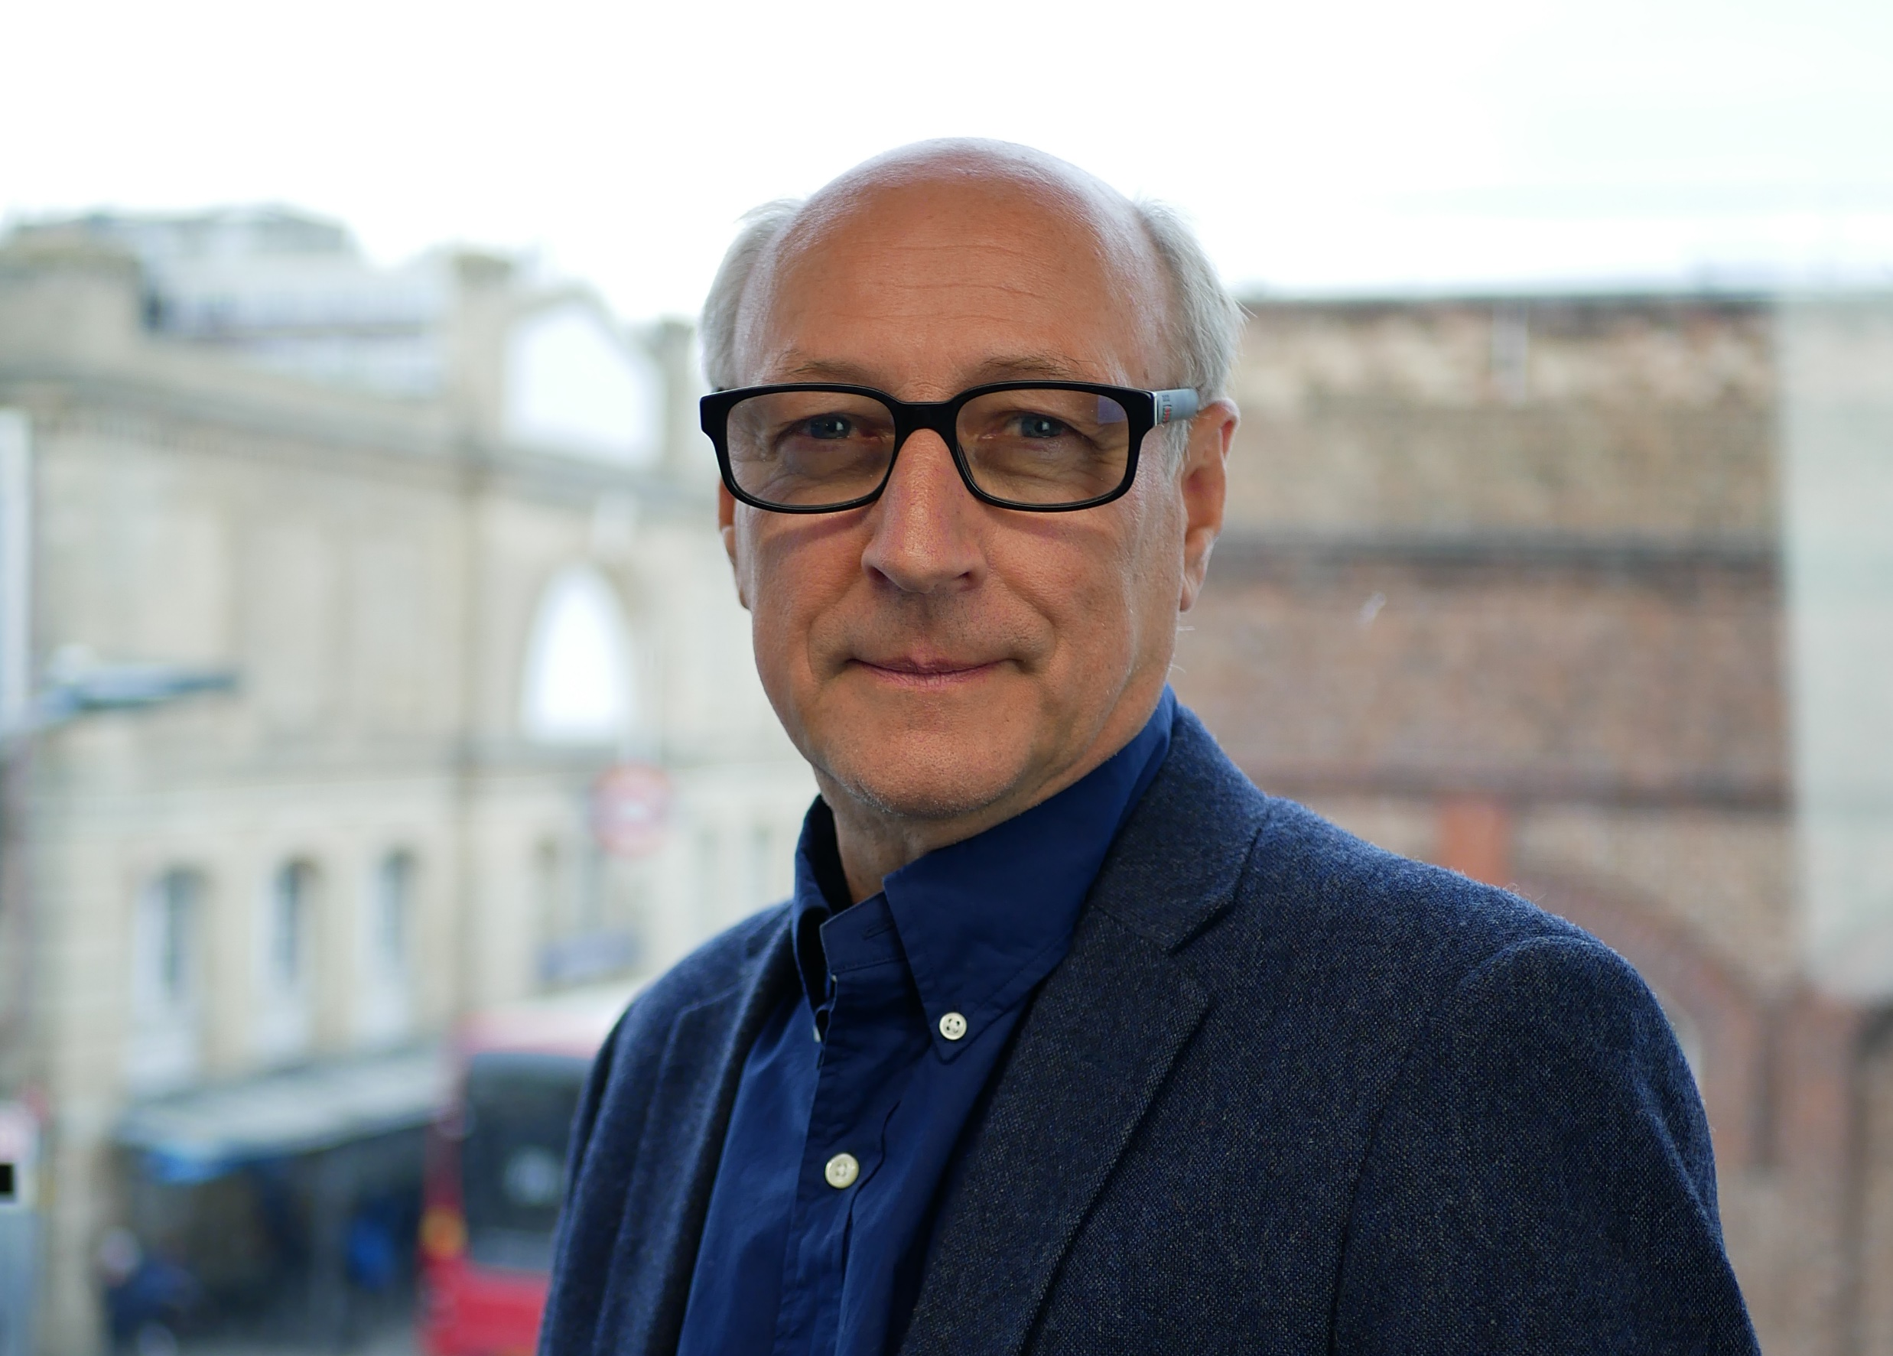
INTRODUCTION
CCUS Technology & Case Studies - Enlit Europe conference session
MICK AVISON - Founder & CEO
Mick is a power station engineer. He trained with CEGB and Powergen, with over 40 years experience in power plant development, construction and operation; over 3,000MW of gas fired power plants on an international basis.
He managed as Director a power generation business in Italy for private investors from 2005 to 2014.
Mick has managed several development companies in the renewable sector and has considerable technical and commercial knowledge of the industry.
Mick established Landmark Power Holdings in 2019 and raised funding for the first project by November 2021.

