Slide 1
Suicide Risk Assessment and Management in C-L Psychiatry
2021 CLP Fundamentals Pre-Conference Course
Scott A. Simpson, MD MPH
Denver Health & University of Colorado School of Medicine

Slide 2
CLP 2021 Disclosure: Scott Simpson, MD MPH
Company | Taylor and Francis | MA Medical Society | American Academy of Addiction Psychiatry
Royalties | I
Consulting/writing |  | I | I
D – Relationship is considered directly relevant to the presentation
I – Relationship is NOT considered directly relevant to the presentation

Slide 3
Objectives
At the end of this talk, I hope you can…
Describe regulatory expectations for suicide screening in the hospital environment
Use standardized models for assessment of suicide risk
Describe elements of systems-based suicide prevention

Slide 4
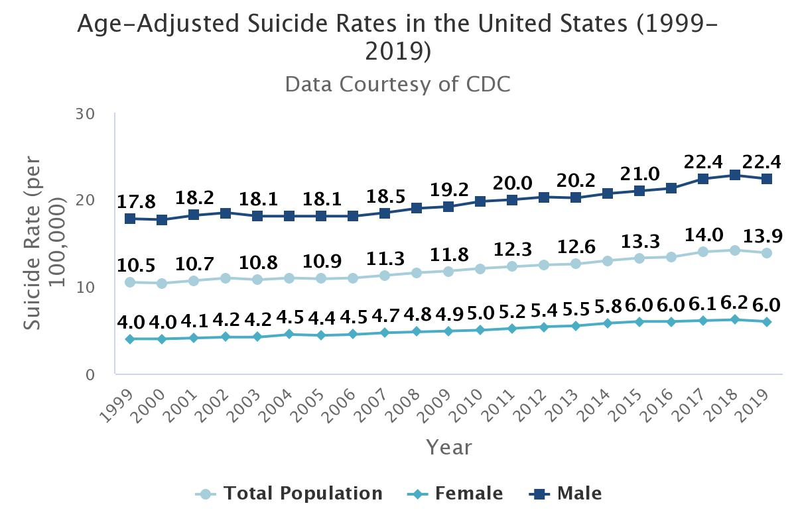
Suicide Incidence in the United States is Increasing

Slide 5
ED and Hospital Visits are Opportunities for Suicide Prevention
Patients who die by suicide are likely to have a healthcare encounter in the preceding month…
Ahmedani 2019 (pmid 31400374)

Slide 6
ED and Hospital Visits are Opportunities for Suicide Prevention
Patients who die by suicide are likely to have a healthcare encounter in the preceding month…
…and patients discharging from hospital settings are at particularly high risk
Ahmedani 2019 (pmid 31400374)

Slide 7
Suicide Risk Assessment: The C-L Psychiatrist’s Role
Systems-based change
Direct clinical care

Slide 8
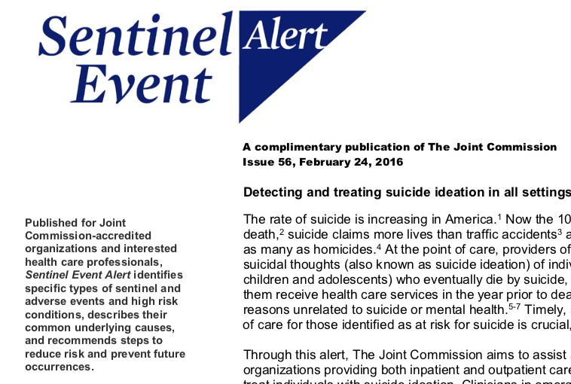
The Joint Commission (TJC) in 2016 (since recanted)
Excerpts
“Screen all patients for suicide ideation, using a brief, standardized, evidence-based screening tool.”
“For all patients with suicide ideation:” 1) Give the national crisis line number, 2) Conduct safety planning, and 3) Restrict access to lethal means”
“Hospitalization is often necessary for a patient’s immediate safety, but hospitalization used solely as a containment strategy may be ineffective or counterproductive and considered by the patient as a disincentive or penalty for expressing suicidal thoughts”

Slide 9
TJC National Patient Safety Goal 15.01.01
Requirement | Comments on implementation
Conduct environmental risk assessment | Different expectations for psychiatric and non-psychiatric units
Screen all individuals served for suicidal ideation using a validated screening tool (starting at age 12) | More discussion to come
Use an evidence-based process to conduct a suicide risk assessment
Document individual’s overall risk and the plan to mitigate risk
Follow policies and procedures addressing care of patients with SI, including training of staff, guidelines for reassessment, and monitoring of high risk patients | Evidence supports providing crisis lines, developing a crisis plan, and ensuring patients connect to care
Monitor implementation and take action as needed | High reliability is key to management

Slide 10
“Validated Screening Tools” for Suicidal Ideation
Columbia-Suicide Severity Rating Scale Clinical Practice Screener
Have you wished you were dead or wish you could go to sleep and not wake up (in the past month)?
Have you actually had any thoughts of killing yourself (in the past month)?
Have you ever done anything, started to do anything or prepared to do anything to end your life (at any point)?
Ask Suicide-Screening Questions
In the past few weeks, have you wished you were dead?
In the past few weeks, have you felt that you or your family would be better off if you were dead?
In the past week, have you been having thoughts about killing yourself?
Have you ever tried to kill yourself?
Are you having thoughts of killing yourself right now?

Slide 11
Content of Common Screeners
 | Columbia-SSRS | Ask Suicide-Screening Questions | Patient Safety Screener (PSS)
Passive SI | ✔ | ✔
Active SI | ✔ | ✔ | ✔
H/o Self-harm | ✔ | ✔ | ✔

Slide 12
The Base Rate Dilemma of Suicide Management
Imagine a test with 99% sensitivity and 99% specificity
Imagine a suicide rate of 500 per 100k person years
What’s the predictive value?
PPV | NPV
33% | 99%
Carter 2017 (28302700)

Slide 13
Additional Limitations
Validated against other screeners—not clinical outcomes
Difficulty in staff implementation
Resource utilization
Ascertainment of other mortality
Symptom over-endorsement
Death by Suicide in the 365 days after PES Discharge
 | Death by suicide | No Suicide
Not-malingering | 16 (0.35%) | 4458
Malingering | Zero | 236
Simpson 2021 (34210531)

Slide 14
Do Screeners Identify Risk?
Sensitivity 18%
Specificity 99%
AUC: 0.57
Simpson 2021 (33346922)
Notes:
# Issue with screener: those missing! Also, this is generally high risk!

Slide 15
Positive screen… now what?

Slide 16
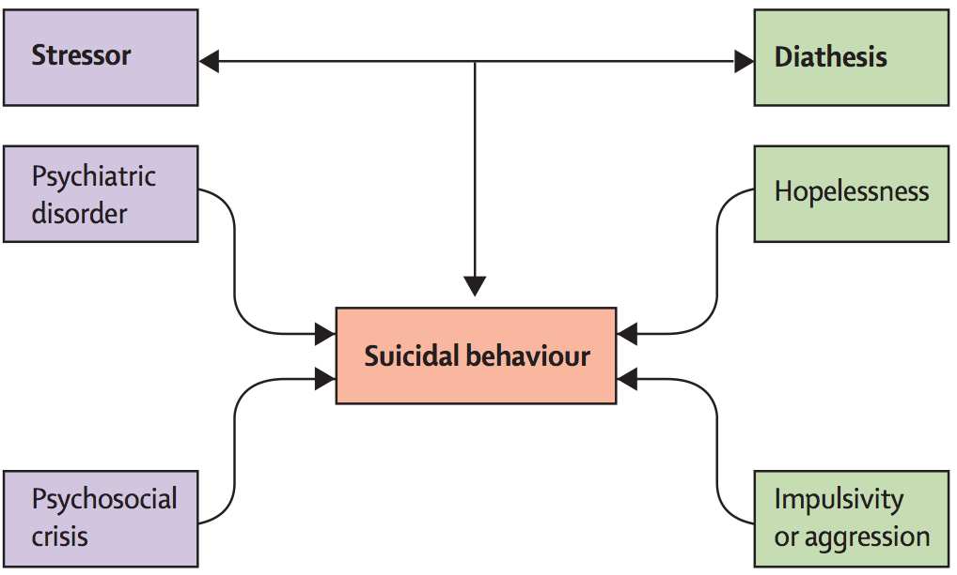
Stress-Diathesis Model
Hawton 2009 (19376453)

Slide 17
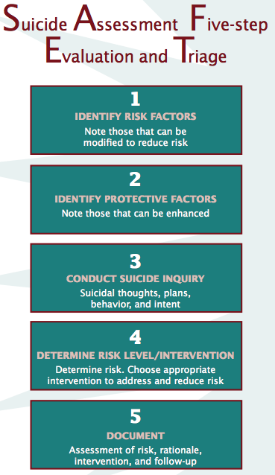
Models for Assessment
SAFE-T
2x2 Table

Slide 18
The Consult Comes In
A 29 transgendered patient who identifies female is seen after an intentional overdose on acetaminophen. She is a nurse who describes feeling overwhelmed by stress at work and finally “snapped” when her boyfriend said he was leaving yesterday. They had an argument, and she sent messages on social media telling him and her other friends that she would soon be dead. Afterwards, she drank a lot of alcohol and took a bottle of pills from her bath cabinet. Her boyfriend had called police, who knocked on the door only several minutes afterwards. In the ED, she was found to have “altered mental status,” an elevated BAL, and an acetaminophen level requiring n-acetylcysteine. Her medical management has come to a denouement, and the team is requesting an assessment for disposition.
The patient has minimal prior psychiatric history and no prior attempts. She reports a history of abuse and non-suicidal self-injury by cutting in her adolescence.

Slide 19
APA lists >100 risk factors
Consider unique factors among C-L patient population
Consider dynamic and manageable risk factors

Slide 20
Limitations in protective factors
Think expansively about intervention
Kroll 2018 (29336787)

Slide 21
Resources
Stressors

Slide 22
Specific questions regarding risk
Train staff to feel comfortable asking, as through specific trainings (eg, Question-Persuade-Refer)
Suicide risk ≠ suicidal ideation

Slide 23
… and document!

Slide 24
“Can I go? I don’t need to be here.”
When your team speaks with the patient, the patient is requesting discharge. She reports that she used to self-harm when stressed but states things had been going well until the pandemic made work so stressful. She is working extra shifts and was sick with COVID last year. She recently had her first panic attack in several years, and it has made her want to avoid going to work. Her boyfriend is her most significant support, and she is worried he will leave her over this. She remarks, “I’m always thinking about being dead but don’t want to do it.”
The boyfriend largely corroborates this. He explains they have “broken up before” but he is glad she is ok. She does not usually drink; “she’s more of a marijuana person.” There are no firearms at home. He will stay with her for at least a few days should she discharge.

Slide 25
2x2 Assessment
 | Acute | Chronic
Risk
Protective

Slide 26
2x2 Assessment
 | Acute | Chronic
Risk | Etoh intoxication | Impulsive Transgendered Panic disorder H/o self-harm and SI
Protective | Willing to engage in treatment | Cultural beliefs against suicide No firearms

Slide 27
2x2 Assessment
 | Acute | Chronic
Risk | Etoh intoxication | Impulsive Transgendered Panic disorder H/o self-harm and SI
Protective | Willing to engage in treatment | Cultural beliefs against suicide No firearms
Modifiable!

Slide 28
Interventions
Psychoeducation to patient and family
Write a safety plan
Lethal means restriction
Identify ONE NEXT BEST provider
Offer follow-up call
Determine disposition
Simpson 2018 (30170836)

Slide 29
Safety Planning
Writing a safety plan and structured phone follow-up among high utilizing veterans (n=96)
Significant improvements in 3 month outcomes:
*
*
Stanley 2015 (26066951)

Slide 30
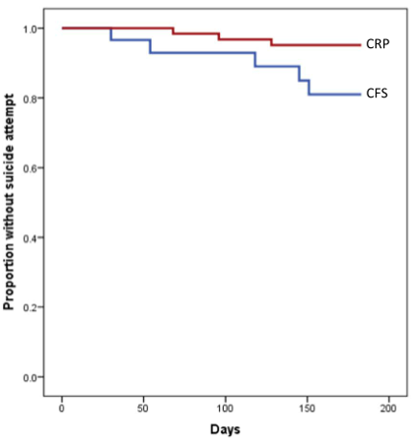
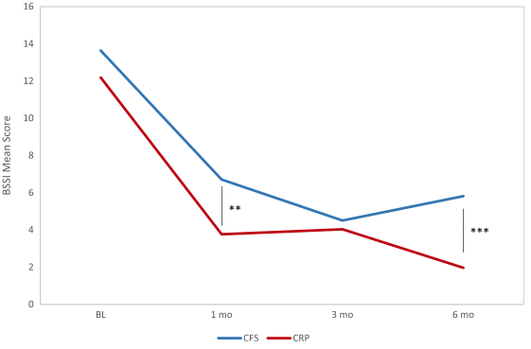
Safety Planning
RCT of 97 active duty soldiers presenting for an emergency appointment
Crisis response plan
Contract for safety
Contract for safety
Crisis response plan
Bryan 2017 (28142085)

Slide 31
Safety Planning
ED-SAFE
3 phases: Treatment as usual (TAU), universal screening, and intervention (safety planning and structured follow-up)
Suicide attempts in 12 month follow-up decrease by 20% with intervention over TAU:
*
Miller 2017 (28456130)

Slide 32
Lead
Train
Identify risk
Engage at-risk individuals
Treat
Transition patients
Improve
https://zerosuicide.edc.org

Slide 33
Train Staff Based on Role
Assessing and Managing Suicide Risk
C-L and Mental Health Clinicians
Counseling on Access to Lethal Means
Non-MH Clinicians
Question-Persuade-Refer
All staff

Slide 34
Improve Implementation
Positive screen referred

Slide 35
Improve Implementation

Slide 36
Improve Implementation

Slide 37
The Biggest Shortcoming?
Simpson 2021 (33346922)

Slide 38
Our Role is Not Only Suicide Prevention

Slide 39
Improving Outcomes
Encounter data
Ongoing program evaluation and research
Realtime mortality outcomes

Slide 40
Objectives
At the end of this talk, I hope you are now able to…
Describe regulatory expectations for suicide screening in the hospital environment
Use standardized models for assessment of suicide risk
Describe elements of systems-based suicide prevention

Slide 41
Questions/thoughts
Scott Simpson MD MPH
Medical Director, Psychiatric Emergency Services
Associate Director of Behavioral Health Services
Associate Professor of Psychiatry, University of Colorado Anschutz Medical Campus
scott.simpson@dhha.org

