Slide 1
Pre-Recording Guide for Presentations

Slide 2
Options for Pre-Recording
Record via Zoom
Recommended when you are showing more than slides and if there are more than one speaker / presenter.
Use an existing Zoom account including the Free version
Record your screen, slides, and camera in a flow (as if you were presenting live)
Record via PowerPoint
Record one or more slides at a time
PowerPoint makes it easy to edit the audio of one slide at a time
The benefit is it is easier to perform an exact script, the downside is PowerPoint recording sounds a bit more monotonous

Slide 3
Recording Via Zoom
Start a Web Meeting (https://zoom.us/start/videomeeting)
Use an existing Zoom account or create a free account
If you have other speakers you are working with be sure to click the Participants tab Then click to Invite them
Once you are ready click Record > Record on this Computer

Slide 4
Recording Via PowerPoint
Load Your Presentation in PowerPoint
Choose Slide Show > Record Slide Show > Record from Beginning

Slide 5
Recording Via PowerPoint
At the Top Left you will notice the Record, Stop and Replay options
Record allows you to record audio for this slide
Replay allows you to hear your Recording
At the top right you’ll see Clear
Clear allows you to clear one slide’s audio or To start over
At the bottom right you’ll see the toggle for your camera

Slide 6
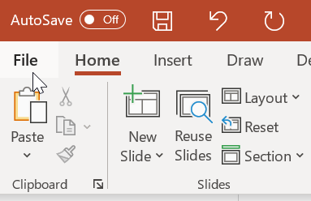
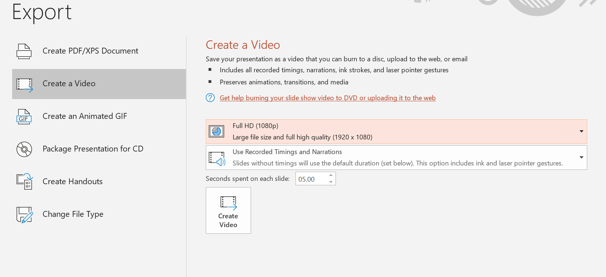
Recording Via PowerPoint
Click on the File > Export option
Choose Create a Video Then click the Create Video button

