Slide 1
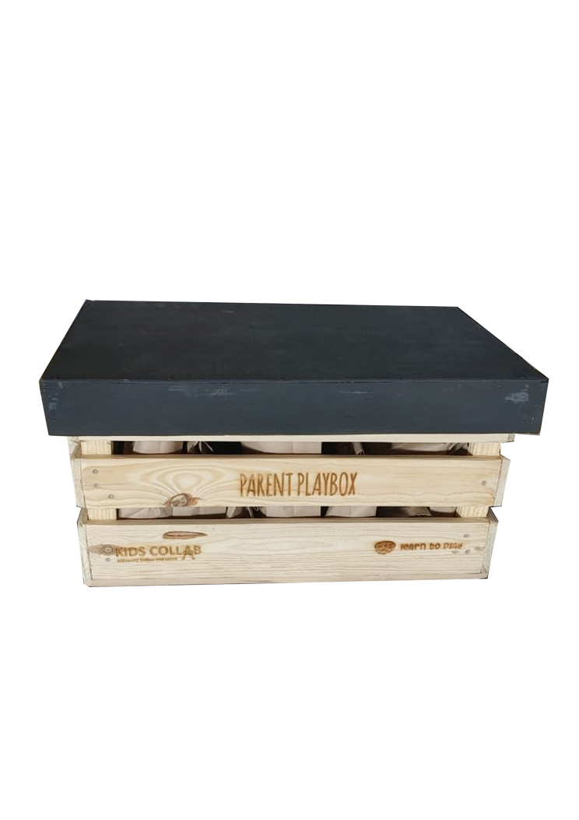
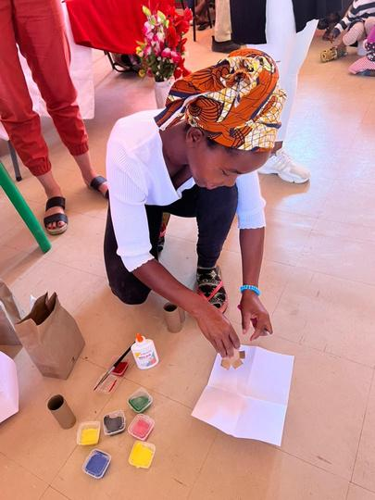
Reallygreat Community
the parent playbox
I-Parent PlayBox iyikhithi yensiza ebanzi eklanyelwe ukunika abazali amandla ekusekeleni ukufunda nokuthuthukiswa kwengane yabo ngemisebenzi ejabulisayo nebandakanyayo.
Faka isicelo ukuze uthole eyodwa!!
Lokho okutholayo:
Joyina isinyathelo se-Parent PlayBox namuhla futhi ungene kwi-adventure ejabulisayo yokuthola, kanye namathuba angapheli nengane yakho!
Iseshini yokuqeqesha
I-PlayBox igcwele imisebenzi nezisetshenziswa
Ukufinyelela eqenjini losekelo lomphakathi elivaliwe
Ukuze uthole okwengeziwe:
www.changex.org (Search for Parent PlayBox)
[Igama lomqali] [imininingwane yokuxhumana no mqali]

